Slide 1


Marketing Management
Sixteenth Edition, Global Edition
Chapter 1
Defining Marketing for the New Realities
Copyright © 2022 Pearson Education Ltd. All Rights Reserved
Notes:
If this PowerPoint presentation contains mathematical equations, you may need to check that your computer has the following installed:
1) MathType Plugin
2) Math Player (free versions available)
3) NVDA Reader (free versions available)

Slide 2
Learning Objectives
1.1 Define the scope of marketing.
1.2 Describe the new marketing realities.
1.3 Explain the role of marketing in the organization.
1.4 Illustrate how to organize and manage a modern marketing department.
1.5 Explain how to build a customer-centric organization.

Slide 3
The Scope of Marketing
Marketing is about identifying and meeting human and social needs
A M A’s formal definition: Marketing is the activity, set of institutions, and processes for creating, communicating, delivering, and exchanging offerings that have value for customers, clients, partners, and society at large
Notes:
Our social definition of marketing: Marketing is a societal process by which individuals and groups obtain what they need and want through creating, offering, and freely exchanging products and services of value with others.

Slide 4
Marketing Management
The art and science of choosing target markets and getting, keeping, and growing customers through creating, delivering, and communicating superior customer value
Notes:
Marketing management takes place when at least one party to a potential exchange thinks about the means of achieving desired responses from other parties.

Slide 5

What is Marketed? (1 of 2)
Goods
Services
Events
Experiences
Persons
Notes:
Marketing involves 10 different domains: goods, services, events, experiences, persons, places, properties, organizations, information, and ideas.

Slide 6
What is Marketed? (2 of 2)
Places
Properties
Organizations
Information
Ideas
Notes:
Marketing involves 10 different domains: goods, services, events, experiences, persons, places, properties, organizations, information, and ideas.

Slide 7
Who Markets?
A marketer is someone who seeks a response—attention, a purchase, a vote, a donation—from another party
Notes:
A marketer seeks to influence the level, timing, and composition of demand to meet the organization’s objectives.

Slide 8
Five Basic Markets
Resource markets
Manufacturer markets
Consumer markets
Intermediary goods markets
Government markets
Notes:
Traditionally, a “market” was a physical place where buyers and sellers gathered to buy and sell goods.
Economists describe a market as a collection of buyers and sellers who negotiate transactions that involve a particular product or product class (such as the housing market or the grain market).
There are five basic markets: resource markets, manufacturer markets, consumer markets, intermediary markets, and government markets.

Slide 9
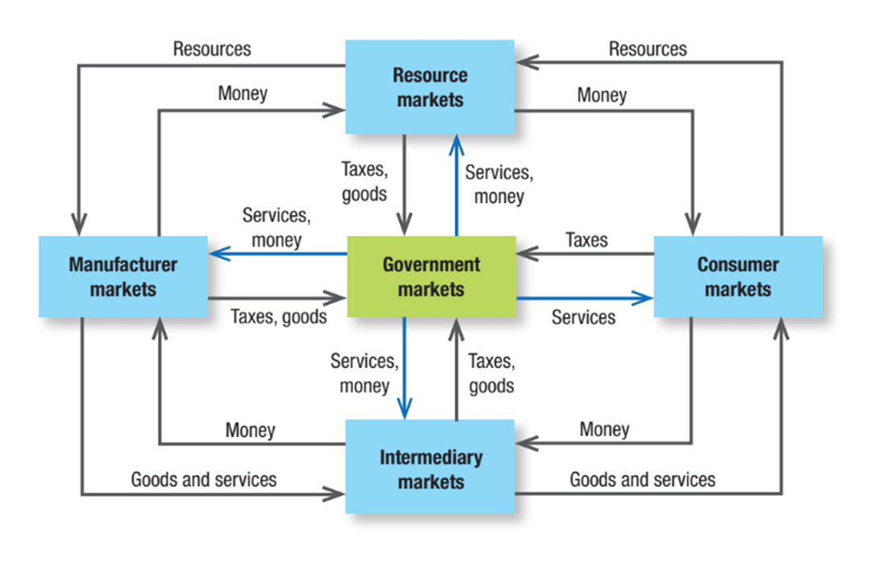
Figure 1.1 Structure of Goods, Services, and Money Flows in a Modern Exchange Economy
Notes:
Five basic markets and their connecting flows are shown in Figure 1.1. Manufacturers go to resource markets (raw material markets, labor markets, money markets), buy resources and turn them into goods and services, and sell finished products to intermediaries, who sell them to consumers. Consumers sell their labor and receive money with which they pay for goods and services. The government collects tax revenues to buy goods from resource, manufacturer, and intermediary markets and uses these goods and services to provide public services. Each nation’s economy, and the global economy, consists of interacting sets of markets linked through exchange processes.
In the illustration, a box at the center labeled Government markets is connected to four boxes on four sides via arrows. The box at the top is labeled Resource markets. The box on the right is labeled Consumer markets. The box at the bottom is labeled Intermediary markets, and the box on the left is labeled Manufacturer markets. The clockwise flow from the top is as follows: Money from Resource markets moves to Consumer markets, then to Intermediary markets, then to Manufacturer markets, and finally back to Resource markets. The anti-clockwise flow from the top is as follows. Resources from Resource markets move to Manufacturer markets. Goods and services from Manufacturer markets move to Intermediary markets, then Goods and Services from Intermediary markets move to Consumer markets, and Resources from Consumer markets move to Resource markets. The upward arrow from Government markets to Resource markets is labeled Services, money, and the downward arrow from Resource markets to Government markets is labeled Taxes, goods. The downward arrow from Government markets to Intermediary markets is labeled Services, money, and the upward arrow from Intermediary markets to Government markets is labeled Taxes, goods. The leftward arrow from Government markets to Manufacturer markets is labeled Services, money, and the rightward arrow from Manufacturer markets to Government markets is labeled Taxes, goods. The rightward arrow from Government markets to Consumer markets is labeled Services, and the leftward arrow from Consumer markets to Government markets is labeled Taxes.

Slide 10

The Market Exchange
Marketers view industry as a group of sellers and use the term market to describe customer groups
Notes:
There are need markets (the diet-seeking market), product markets (the shoe market), demographic markets (the “Millennium” youth market), and geographic markets (the Chinese market), as well as voter markets, labor markets, and donor markets.

Slide 11
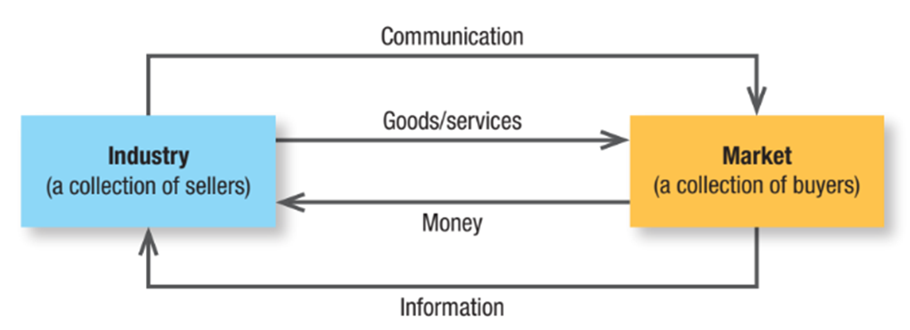
Figure 1.2 A Simple Marketing System
Notes:
Figure 1.2 shows how sellers and buyers are connected by four flows. Sellers send goods and services and communications such as ads and direct mail to the market; in return they receive money and information such as customer attitudes and sales data. The inner loop shows an exchange of money for goods and services; the outer loop shows an exchange of information.
In the illustration, a box on the left labeled Industry (a collection of sellers) and a box on the right labeled Market (a collection of buyers) are connected via arrows. Two arrows labeled Communication and Goods, services point from Industry to Market, and two arrows labeled Money and Information point from Market to Industry.

Slide 12
The New Marketing Realities
The market forces that shape the relationships among the different market entities
The market outcomes that stem from the interplay of these forces
The emergence of holistic marketing as an essential approach to succeeding in the rapidly evolving market
Notes:
The marketplace is dramatically different from even 10 years ago, with new marketing behaviors, opportunities, and challenges emerging.

Slide 13
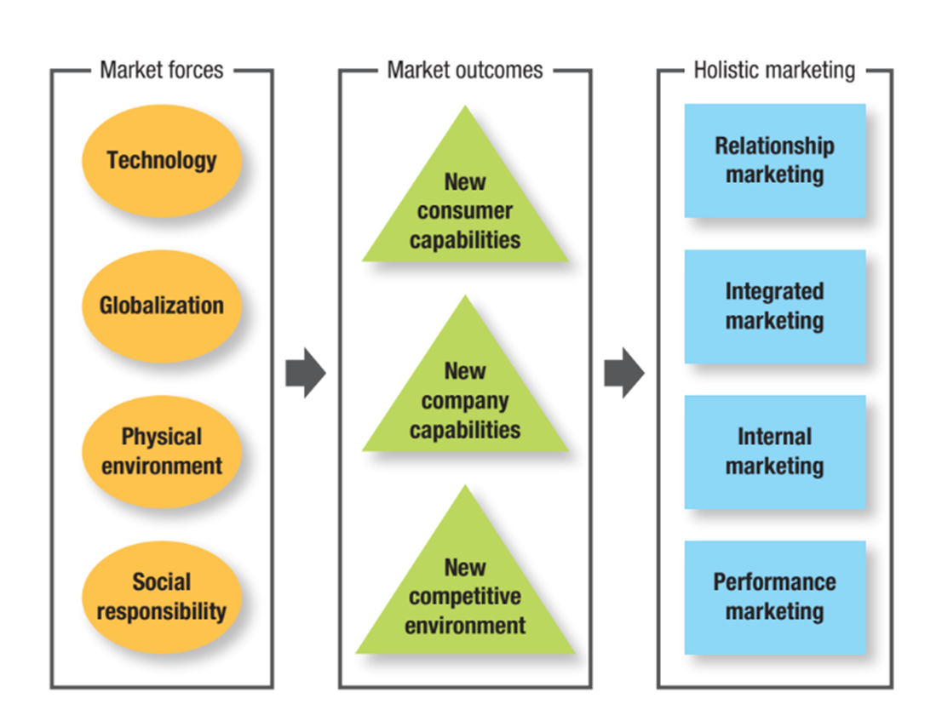
Figure 1.3 The New Marketing Realities
Notes:
Figure 1.3 summarizes the four major market forces, three key market outcomes, and four fundamental pillars of holistic marketing that help to capture the new marketing realities. With these concepts in place, we can identify a specific set of tasks that make up successful marketing management and marketing leadership.
In the flowchart, from left to right, the entries are as follows: Market forces, Technology, Globalization, Physical environment, and Social responsibility; Market outcomes, New consumer capabilities, New company capabilities, and New competitive environment, and Holistic marketing, Relationship marketing, Integrated marketing, Internal marketing, and Performance marketing.

Slide 14
Major Market Forces
Technology
Globalization
Physical environment
Social responsibility
Notes:
Technology: Massive amounts of information and data about almost everything are now available to consumers and marketers. Technological developments have given birth to new business models that take advantage of the new capabilities stemming from these technologies. Even traditional marketing activities are profoundly affected by technology.
Globalization: The world has become a smaller place. Geographic and political barriers have been eroded as advanced telecommunication technologies and workflow platforms that enable all types of computers to work together continue to create almost limitless opportunities for communication, collaboration, and data mining. Globalization has made countries increasingly multicultural and changes innovation and product development as companies take ideas and lessons from one country and apply them to another.
Physical environment: Two particularly far-ranging changes in the physical environment deserve special attention: climate change and changes in global health conditions. Climate change can have a profound effect on the business models of virtually all companies regardless of their size or the industry in which they operate. Health conditions range from short-term illnesses that are confined to a particular geographic area to pandemics that spread across the globe.
Social responsibility: The private sector is taking some responsibility for improving living conditions, and firms all over the world have elevated the role of corporate social responsibility. Because marketing’s effects extend to society as a whole, marketers must consider the ethical, environmental, legal, and social context of their activities. Social responsibility is a way to differentiate from competitors, build consumer preference, and achieve notable sales and profit gains.

Slide 15
A Dramatically Changed Marketplace (1 of 5)
New consumer capabilities
  Can use online resources as a powerful information and purchasing aid
  Can search, communicate, and purchase on the move
  Can tap into social media to share opinions and express loyalty
Notes:
The four major forces shaping today’s markets—technology, globalization, the physical environment, and social responsibility—are fundamentally changing the ways consumers and companies interact with each other. Expanded information, communication, and mobility enable customers to make better choices and share their preferences and opinions with others around the world.

Slide 16
A Dramatically Changed Marketplace (2 of 5)
New consumer capabilities
  Can actively interact with companies
  Can reject marketing they find inappropriate or annoying
  Can extract more value from what they already own
Notes:
The four major forces shaping today’s markets—technology, globalization, the physical environment, and social responsibility—are fundamentally changing the ways consumers and companies interact with each other. Expanded information, communication, and mobility enable customers to make better choices and share their preferences and opinions with others around the world.

Slide 17
A Dramatically Changed Marketplace (3 of 5)
New company capabilities
  Can use the internet as a powerful information and sales channel, including for individually differentiated goods
  Can collect fuller and richer information about markets, customers, prospects, and competitors
  Can reach customers quickly and efficiently via social media and mobile marketing, sending targeted ads, coupons, and information
Notes:
At the same time, globalization, social responsibility, and technology have also generated a new set of capabilities to help companies cope and respond.

Slide 18
A Dramatically Changed Marketplace (4 of 5)
New company capabilities
  Can improve purchasing, recruiting, training, and internal and external communications
  Can improve cost efficiency
Notes:
At the same time, globalization, social responsibility, and technology have also generated a new set of capabilities to help companies cope and respond.

Slide 19
A Dramatically Changed Marketplace (5 of 5)
New competitive environment
  Deregulation
  Privatization
  Retail transformation
  Disintermediation
  Private labels
  Mega-brands
Notes:
The new market forces have not only changed consumer and company capabilities; they have also dramatically changed the dynamics of the competition and the nature of the competitive landscape.

Slide 20
What is Holistic Marketing?
An integrated approach to managing strategy and tactics
  Relationship marketing
  Integrated marketing
  Internal marketing
  Performance marketing
Notes:
The market value concept calls for a holistic approach to marketing that is focused on building relationships, rather than on generating transactions; on integrated marketing that is both automated and creative, rather than on manually managed piecemeal marketing actions; on internal marketing that reflects a strong corporate culture rather than disengaged employees; and on performance-focused marketing that is driven by science rather than intuition.

Slide 21
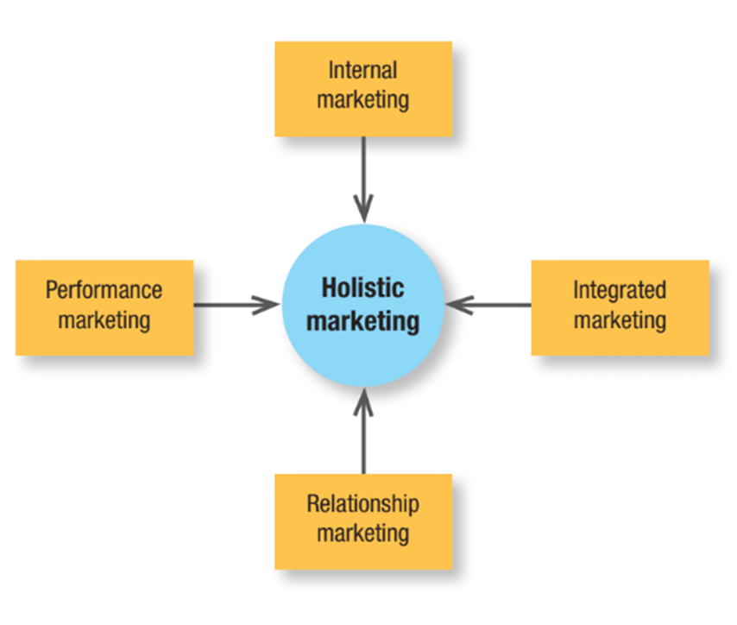
Figure 1.4 The Concept of Holistic Marketing
Notes:
Figure 1.4 provides a schematic overview of four broad components characterizing holistic marketing: relationship marketing, integrated marketing, internal marketing, and performance marketing.
In the illustration, a circle labeled Holistic marketing is at the center, and four boxes on four sides point at it with arrows. The box at the top is labeled Internal marketing. The box on the right is labeled Integrated marketing. The box at the bottom is labeled Relationship marketing, and the box on the left is labeled Performance marketing.

Slide 22
Relationship Marketing (1 of 3)
Relationship marketing aims to build mutually satisfying long-term relationships with key constituents in order to earn and retain their business
Notes:
Increasingly, a key goal of marketing is to develop deep, enduring
relationships with people and organizations that directly or indirectly affect the success of the firm’s marketing activities.

Slide 23

Relationship Marketing (2 of 3)
Customers
Employees
Marketing partners
Financial community
Notes:
Four key constituents for relationship marketing are customers, employees, marketing partners (channels, suppliers, distributors, dealers, agencies), and members of the financial community (shareholders, investors, analysts).
Marketers must create prosperity among all these constituents and balance the returns to all key stakeholders. To develop strong relationships with them requires understanding their capabilities and resources, needs, goals, and desires.
The ultimate outcome of relationship marketing is a unique company asset called a marketing network, consisting of the company and its supporting stakeholders—customers, employees, suppliers, distributors, retailers, and others—with whom it has built mutually profitable business relationships.
The operating principle is simple: build an effective network of relationships with key stakeholders, and profits will follow.

Slide 24
Relationship Marketing (3 of 3)
The ultimate outcome of relationship marketing is a unique company asset called a marketing network, which consists of the company and its supporting stakeholders with whom it has built mutually profitable business relationships
Notes:
The ultimate outcome of relationship marketing is a unique company asset called a marketing network, which consists of the company and its supporting stakeholders—customers, employees, suppliers, distributors, retailers, and others—with whom it has built mutually profitable business
relationships.

Slide 25

Integrated Marketing
Devise marketing activities and programs that create, communicate, and deliver value such that “the whole is greater than the sum of its parts.”
Notes:
Integrated marketing coordinates all marketing activities and marketing programs and directs them toward creating, communicating, and delivering consistent value and a consistent message for consumers, such that “the whole is greater than the sum of its parts.”
This requires that marketers design and implement each marketing activity with all other activities in mind.

Slide 26
Internal Marketing
The task of hiring, training, and motivating able employees who want to serve customers well
Notes:
Marketing succeeds only when all departments work together to achieve customer goals: when engineering designs the right products, finance furnishes the right amount of funding, purchasing buys the right materials, production makes the right products in the right time horizon, and accounting measures profitability in the right ways.
Such interdepartmental harmony can truly coalesce, however, only when senior management clearly communicates a vision of how the company’s marketing orientation and philosophy serve customers.

Slide 27
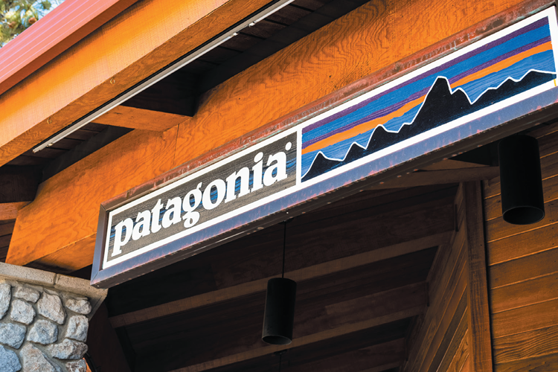
Performance Marketing
Financial accountability
Environmental impact
Social impact
Notes:
Performance marketing requires understanding the financial and nonfinancial returns to business and society from marketing activities and programs.
When they founded Ben & Jerry’s, Ben Cohen and Jerry Greenfield embraced the performance marketing concept by dividing the traditional financial bottom line into a “double bottom line” that also measured the environmental impact of their products and processes. That later expanded into a “triple bottom line” to represent the social impacts, negative and positive, of the firm’s entire range of business activities.
Patagonia is one of a small number of benefit (B) corporations in the United States that must each year explain how their mission is benefiting both stakeholders and society, Patagonia aims to combine environmental consciousness with maximizing shareholder returns.

Slide 28
Defining the Role of Marketing in the Organization
Production concept
Product concept
Selling concept
Marketing concept
Market-value concept
Notes:
A company must decide what overarching philosophy will guide a company’s marketing efforts, determine how to organize and manage the marketing department, and, ultimately, find the best means to build a customer-centric organization that can deliver value to company stakeholders.
The production concept is one of the oldest concepts in business. It holds that consumers prefer products that are widely available and inexpensive.
The product concept proposes that consumers favor products offering the highest quality, the best performance, or innovative features.
The selling concept holds that consumers and businesses, if left alone, won’t buy enough of the organization’s products.
The marketing concept emerged in the mid-1950s as a customer-centered, sense-and-respond philosophy. The job of marketing is not to find the right customers for your products but to develop the right products for your customers.
The market-value concept is based on the development, design, and implementation of marketing programs, processes, and activities that recognize their breadth and interdependencies. The value-based view of marketing acknowledges that everything matters in marketing—and that a broad, integrated perspective is often necessary.

Slide 29
Table 1.1 Product-Oriented versus Market-Value-Oriented Definitions of a Business
Company | Product Definition | Market-Value Definition
Union Pacific Railroad | We run a railroad. | We move people and goods.
Xerox | We make copying equipment. | We help improve office productivity.
Hess Corporation | We sell gasoline. | We supply energy.
Paramount Pictures | We make movies. | We market entertainment.
Encyclopedia Britannica | We sell encyclopedias online. | We distribute information.
Carrier | We make air conditioners and furnaces. | We provide climate control in the home.
Notes:
Table 1.1 lists companies that have moved from a product definition to a market-value definition of their business.

Slide 30
Organizing the Marketing Department
Functional organization
Geographic organization
Product or brand organization
Market organization
Matrix organization
Notes:
The structure of the marketing department plays a major role in a company’s ability to create market value. Company success is determined not only by the skills of the individual marketers but also, and to a large degree, by the way the marketers are organized to create a high-performing marketing team.
In the most common form of marketing organization, functional specialists report to a chief marketing officer who coordinates their activities.
A company selling in a national market often organizes its sales force (and sometimes its marketing) along geographic lines. Some companies are adding area market specialists (regional or local marketing managers) to support sales efforts in high-volume markets. Some companies must develop different marketing programs in different parts of the country, because geography substantially alters their brand development activities.
Companies producing a variety of products and brands often establish a product- or brand-management organization. This does not replace the functional organization but serves as another layer of management. A group product manager supervises product category managers, who in turn supervise specific product and brand managers.
When customers fall into different user groups with distinct buying preferences and practices, a market-management organization is desirable.
Companies that produce many products for many markets may adopt a matrix structure employing both product and market managers. One of the key disadvantages of the matrix structure though, is the potential lack of clear focus and accountability.

Slide 31
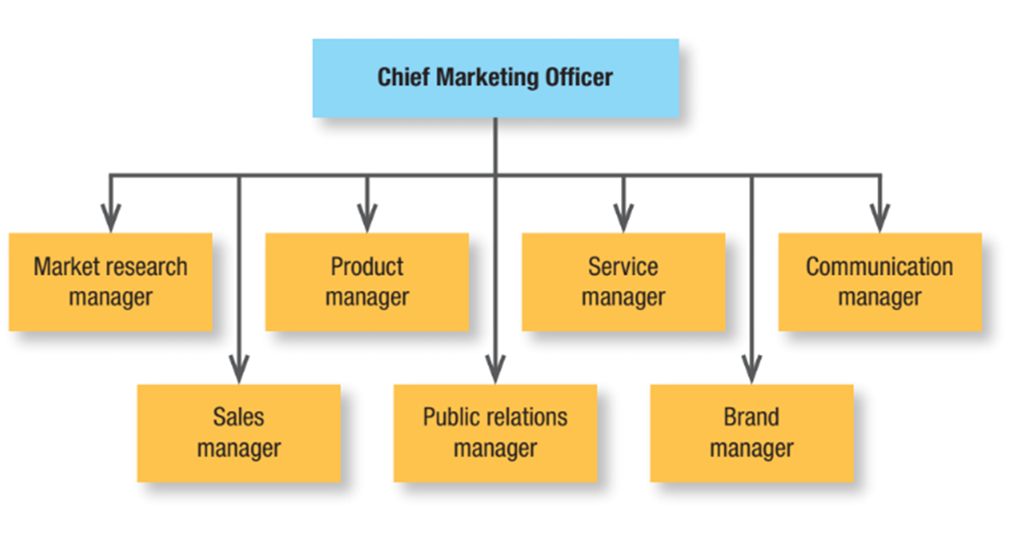
Figure 1.5 Functional Organization
Notes:
Figure 1.5 shows seven specialists. Other specialists might include a marketing planning manager, a market logistics manager, a direct marketing manager, a social media manager, and a digital marketing manager.
The main advantage of a functional marketing organization is its administrative simplicity. However, it can be quite a challenge for the departments to develop smooth working relationships, which can result in inadequate planning as the number of products and markets increases and the functional groups vie for budget and status.
However, it can be quite a challenge for the departments to develop smooth working relationships, which can result in inadequate planning as the number of products and markets increases and the functional groups vie for budget and status. The marketing vice president constantly weighs competing claims and faces a difficult coordination problem.
The flowchart shows a box on the top labeled Chief Marketing Officer is connected to seven boxes labeled Market research manager, Sales Manager, Product Manager, Public relations manager, Service manager, Brand manager, and Communication manager from left to right, respectively.

Slide 32
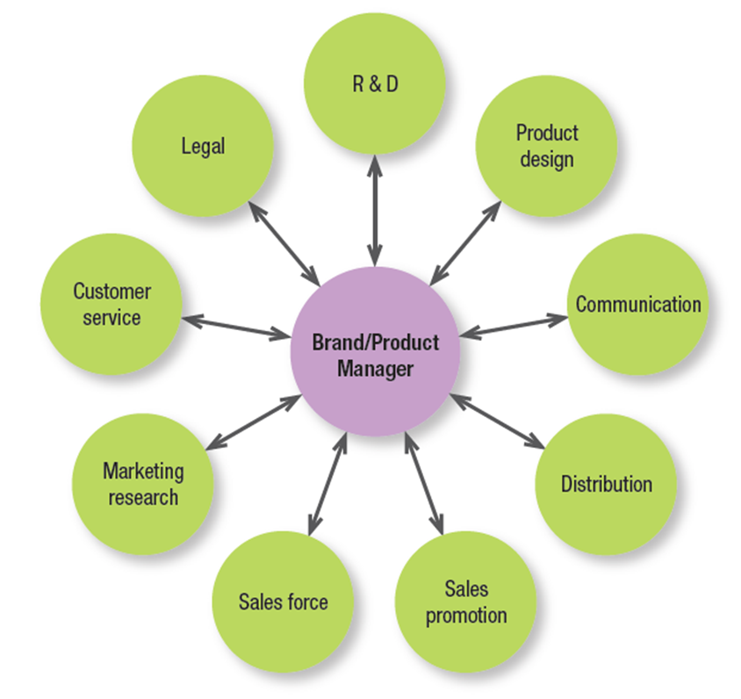
Figure 1.6 The Product Manager’s Interactions
Notes:
A product-management organization makes sense if the company’s products are quite different or if there are more products than a functional organization can handle.
This form is sometimes characterized as a hub-and-spoke system. As shown in Figure 1.6, the brand or product manager is figuratively at the center, with spokes leading to various departments representing working relationships.
The product-management organization lets the product manager concentrate on developing a cost-effective marketing program and react more quickly to new products in the marketplace; it also gives the company’s smaller brands a product advocate.
But it has disadvantages, too. Product and brand managers may lack authority to carry out their responsibilities. They often become experts in their product area but rarely achieve functional expertise. Another challenge is that brand managers normally manage a brand for only a short time. Short-term involvement leads to short-term planning and fails to build long-term strengths. The fragmentation of markets makes it harder to develop a national strategy. Brand managers must please regional and local sales groups, transferring power from marketing to sales. Another important consideration is that product and brand managers focus the company on building market share rather than customer relationships.
A circle labeled Brand, Product Manager is at the center, and nine circles with double-headed arrows are around it. The circles starting at the top are labeled as follows. R and D, Product design, Communication, Distribution, Sales promotion, Sales force, Marketing research, Customer service, and Legal.

Slide 33
Managing the Marketing Department
The role of the C E O and the C M O
Relationships with other departments
Notes:
As David Packard of Hewlett-Packard observed, “Marketing is far too important to leave to the marketing department . . . . In a truly great marketing organization, you can’t tell who’s in the marketing department. Everyone in the organization has to make decisions based on the impact on the customer.”

Slide 34
The Role of the C E O
Convince senior management of the importance of being customer focused
Hire strong marketing talent
Facilitate the creation of strong in-house marketing training programs
Appoint a chief marketing officer
Notes:
CEOs recognize that marketing builds strong brands and a loyal customer base, intangible assets that contribute heavily to the value of a firm.

Slide 35
The Role of the C M O
Act as the visionary for the future of the company
Build adaptive marketing capabilities
Win the war for marketing talent
Tighten the alignment with sales
Take accountability for returns on marketing spending
Infuse a customer perspective in business decisions affecting any customer touch point
Notes:
The CMO leads all marketing functions in the organization, including product development, brand management, communication, market research and data analytics, sales, promotion, distribution management, pricing, and customer service.

Slide 36
Relationships with Other Departments
Marketers must work closely with:
  customer insights and data analytics teams
  different communication agencies
  channel partners
Notes:
The firm’s success depends not only on how well each department performs its work, but also on how well the company coordinates departmental activities to conduct core business processes. Under the marketing concept, all departments need to “think customer” and work together to satisfy customer needs and expectations.

Slide 37
Building a Customer-Oriented Organization
Create long-term customer value
  Requires managers at every level to be personally engaged in understanding, meeting, and serving customers
Customers expect companies to listen and respond to them
Notes:
The proliferation of products, services, and brands; increased consumer knowledge about market offerings; and consumers’ ability to influence public opinion about companies and their offerings—all have underscored the importance of building a customer-oriented organization.
With the rise of digital technologies, increasingly informed consumers expect companies to do more than connect with, satisfy, and even delight them. They expect companies to listen and respond to them.

Slide 38
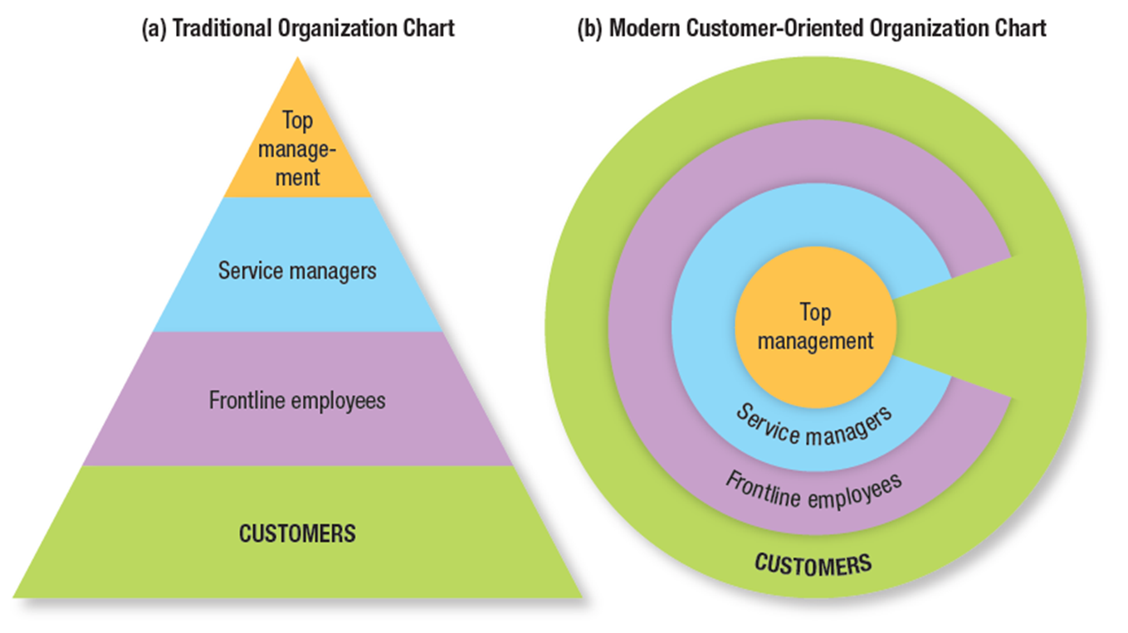
Figure 1.7 Traditional Organization versus Modern Customer-Oriented Company Organization
Notes:
Figure 1.7 shows a traditional organization and a modern customer-oriented company organization.
Managers who believe the customer is the company’s only true “profit center” consider the traditional organization chart in Figure 1.7(a)—a pyramid with the president at the top, management in the middle, and frontline people and customers at the bottom—to be obsolete.
Successful marketing companies transform the traditional organization-hierarchy chart to look like the chart in Figure 1.7(b). A company’s top priority are customers; next in importance are the frontline people who meet, serve, and satisfy these customers; then come service managers, whose job is to support the frontline people so they can serve customers well; and finally, there is the top management, whose job is to hire and support good service managers.
Chart 1. A pyramid titled Traditional organization chart is labeled from top to bottom as follows. Top management, Service managers, Frontline employees, and Customers. Chart 2. A set of concentric circles titled Modern customer-oriented organization chart are labeled from outside in as follows. Top management, Service managers, Frontline employees, and Customers.

Slide 39
Becoming a Market-Driven Company
Develop a company-wide passion for customers
Organize around customer segments instead of products
Understand customers through qualitative and quantitative research
Notes:
Many companies realize they’re not yet really market and customer driven; rather, they are product and sales driven.
Transforming into a true market-driven company requires (among other actions) developing a company-wide passion for customers, organizing around customer segments instead of products, and understanding customers through qualitative and quantitative research.
Although it’s necessary to be customer oriented, it’s not enough. The organization must also be creative.
Companies today copy one another’s advantages and strategies with increasing speed, making differentiation harder to achieve and lowering margins as firms become more alike.

Slide 40
Table 1.2 Characteristics of Customer-Centric Organizations
Low Customer-Centricity | High Customer-Centricity
Product driven | Market driven
Mass market focused | Customer focused
Process oriented | Outcome oriented
Reacting to competitors | Making competitors irrelevant
Price driven | Value driven
Hierarchical organization | Teamwork
Notes:
Table 1.2 shows the characteristics of customer-centric organizations.
Although it’s necessary to be customer oriented, it’s not enough. The organization must also be creative.
Companies today copy one another’s advantages and strategies with increasing speed, making differentiation harder to achieve and lowering margins as firms become more alike.
The best answer to this dilemma is to build capability in strategic innovation and imagination. This capability comes from assembling tools, processes, skills, and measures that let the firm generate more and better new ideas than its competitors.
To encourage such capability, companies should strive to put together inspiring work spaces that help stimulate new ideas and foster imagination.

Slide 41
Discussion Questions (1 of 2)
For many Starbucks’ customers, buying a favorite drink now involves a few clicks on the Starbucks app and a pick-up at the counter.
  How is technology changing the way Starbucks interacts with its customers?
  What benefits does this offer?
  What challenges does it present?

Slide 42
Discussion Questions (2 of 2)
Amazon’s success at anticipating customer needs and fulfilling them is evidenced by its record-breaking profits.
  How does Amazon create value for its customers?
  What are the tradeoffs between the convenience Amazon offers and the sustainability issues its business model creates?

