Slide 1
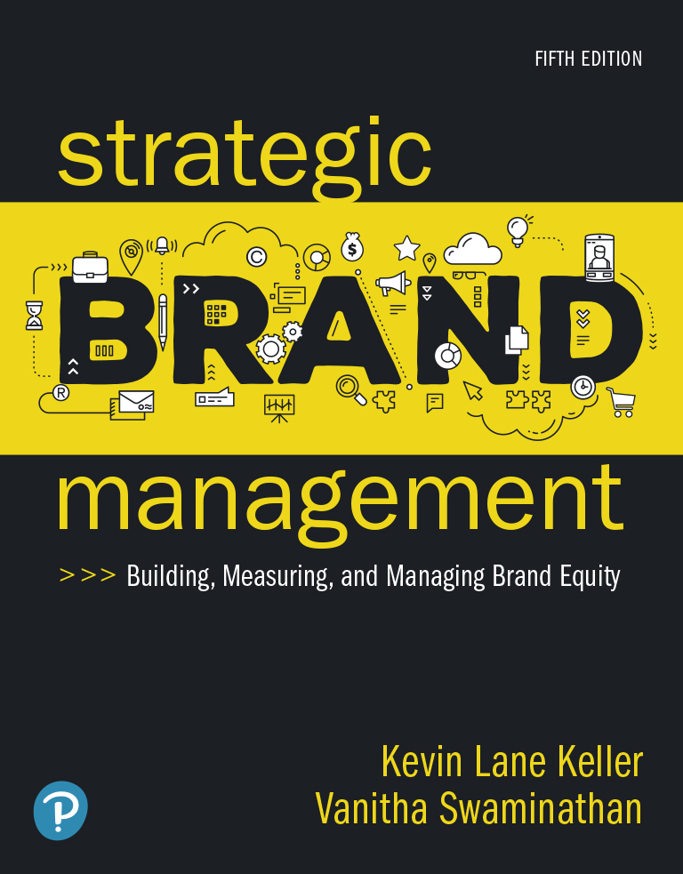
Strategic Brand Management: Building, Measuring, and Managing Brand Equity
Fifth Edition
Chapter 1
Brands and Brand Management
Copyright © 2020, 2013, 2008 Pearson Education, Inc. All Rights Reserved
Notes:
If this PowerPoint presentation contains mathematical equations, you may need to check that your computer has the following installed:
1) MathType Plugin
2) Math Player (free versions available)
3) NVDA Reader (free versions available)

Slide 2
Learning Objectives
1.1 Define “brand,” state how brand differs from a product, and explain what brand equity is
1.2 Summarize why brands are important
1.3 Explain how branding applies to virtually everything
1.4 Describe the main branding challenges and opportunities
1.5 Identify the steps in the strategic brand management process

Slide 3
What is a Brand?
Brand Elements
Brands versus Products
Notes:
Brand
According to the American Marketing Associate (AMA), a brand is a “name, term, sign, symbol, or design, or a combination of them, intended to identify the goods and services of one seller or group of sellers and to differentiate them from those of competition.”
Whenever a marketer creates a new name, logo, or symbol for a new product, a brand has been created.
Creates a certain amount of awareness, reputation, prominence, and so on in the marketplace.

Slide 4
Brand Elements
The key to creating a brand:
  Able to choose a name, logo, symbol, package design, or other characteristic that identifies a product
  Distinguishes it from other products
Components that identify and differentiate a brand are brand elements

Slide 5
Brands Versus Products (1 of 3)
Five levels of meaning for a product:
  Core benefit level
  Generic product level
  Expected product level
  Augmented product level
  Potential product level
Notes:
Five levels of meaning for a product:
Core benefit level: Fundamental need or want that consumers satisfy by consuming the product or service.
Generic product level: Basic version of the product containing only those attributes or characteristics absolutely necessary for its functioning but with no distinguishing features.
Expected product level: Set of attributes or characteristics that buyers normally expect and agree to when they purchase a product.
Augmented product level: Additional product attributes, benefits, or related services that distinguish the product from competitors.
Potential product level: All the augmentations and transformations that a product might ultimately undergo in the future.

Slide 6
Brands Versus Products (2 of 3)
A product is anything we can offer to a market for attention, acquisition, use, or consumption:
  That might satisfy a need or want
  Physical good like a cereal, tennis racquet, or car
A brand is more than a product since it can have dimensions that differentiate it from other products
Notes:
Product
A physical good: cereal, tennis racquet, or automobile
A service: an airline, bank, or insurance company
A retail outlet: department store, specialty store, or super market
A person: political figure, professional entertainer, or athlete
A place: city or country
An idea or a social cause
Brand
Is more than a product
Can have dimensions that differentiate it in some way
May be rational and tangible—related to product performance of the brand—or more symbolic, emotional, and intangible—related to what the brand represents
A branded product may be:
A physical good like Kellogg’s corn flakes cereal, Prince tennis racquets, or Ford Mustang automobiles
A service such as Delta Airlines, Bank of America, or Allstate insurance

Slide 7
Brands Versus Products (3 of 3)
Differences between a product and a brand may be:
  Rational and tangible:
    Related to product performance of the brand
  Or may be more symbolic, emotional, and intangible:
    Related to what the brand represents

Slide 8
Figure 1-2: Ten Firms Rated Highly in Innovation
Apple
Netflix
Square
Tencent
Amazon
Patagonia
C V S Health
The Washington Post
Spotify
N B A
Source: Based on Fast Company’s 2018 List of Most Innovative Companies.

Slide 9
Why Do Brands Matter?
Consumers
Firms
Notes:
Why are brands important? What functions do they perform that make them so valuable to marketers?

Slide 10
Consumers (1 of 3)
Functions provided by brands to consumers:
  Identify the source or maker of the product
  Simplify product decisions
  Lower the search costs for products internally and externally
  Helps set reasonable expectations about what consumers may not know about the brand

Slide 11
Consumers (2 of 3)
Brand can signal product characteristics and attributes:
  On the basis of attributes products can be classified as:
    Search goods
    Experience goods
    Credence goods
Notes:
Products can be classified by their associated attributes or benefits
Search goods:
Evaluated on the basis of attributes such as sturdiness, size, color, style, design, weight, and ingredient composition by visual inspection.
Example - Grocery
Experience goods:
Evaluated on the basis of features such as durability, service quality, safety, and ease of handling.
Example - Automobile tires
Credence goods:
Consumers may rarely learn attributes.
Example - Insurance

Slide 12
Consumers (3 of 3)
Brands can reduce risks in product decision:
  These risk can be categorised as:
    Functional, physical, financial, social psychological, and time
Notes:
Risks:
Functional risk—Product does not perform up to expectations.
Physical risk—Product poses a threat to the physical well-being or health of the user or others.
Financial risk—Product is not worth the price paid.
Social risk—Product results in embarrassment from others.
Psychological risk—Product affects the mental well-being of the user.
Time risk—Failure of the product results in an opportunity cost of finding another satisfactory product.

Slide 13
Firms
Brands provide valuable functions to a firm:
  Simplify product handling and tracing
  Help organizing inventory and accounting records
  Offer the firm legal protection for unique features or aspects of the product
  Provide predictability and security of demand for the firm and creates barriers of entry for competitors
  Provide a powerful means to secure competitive advantage

Slide 14
Figure 1-3: Roles That Brands Play
Consumers
Identification of source of product
Assignment of responsibility to product maker
Risk reducer
Search cost reducer
Promise, bond, or pact with maker of product
Symbolic device
Signal of quality
Manufacturers
Means of identification to simplify handling or tracing
Means of legally protecting unique features
Signal of quality level to satisfied customers
Means of endowing products with unique associations
Source of competitive advantage
Source of financial returns

Slide 15
Figure 1-4: Brand Value as a Percentage of Market Capitalization
Company | Brand Value (in $ billions) | Total Value (in $ billions) | Brand Value as a Percentage of Overall Value
Apple | 184.1 | 868.88 | 21%
Google | 141.7 | 729.1 | 19%
Microsoft | 79.9 | 659.9 | 12%
Coca-Cola | 69.7 | 195.5 | 36%
Amazon | 64.7 | 563.5 | 11%
Samsung | 56.2 | 300 | 19%
Toyota | 50.3 | 188.2 | 27%
Facebook | 48.2 | 420.8 | 11%
Mercedes | 47.8 | 79.3 | 60%
I B M | 46.8 | 142 | 33%
Sources: Based on Inter-brand, “Best Global Brands 2010.” Yahoo! Finance, February 11.

Slide 16
Can Anything Be Branded? (1 of 2)
Physical Goods
Services
Notes:
Brands clearly provide important benefits to both consumers and firms. How, then, are brands created? How do you “brand” a product?

Slide 17
Can Anything Be Branded? (2 of 2)
To brand a product, it is necessary to teach consumers “who” the product is:
  Giving it a name and using other brand elements to help identify it
  What the product does and why consumers should care
Marketers must give consumers a label for the product and provide meaning for the brand
Marketers can benefit from branding whenever consumers are in a choice situation
Notes:
Branding creates mental structures and helps consumers organize their knowledge about products and services in a way that clarifies their decision making and, in the process, provides value to the firm. The key to branding is that consumers perceive differences among brands in a product category. These differences can be related to attributes or benefits of the product or service itself, or they may be related to more intangible image considerations.

Slide 18
Physical Goods
Physical goods are what are traditionally associated with brands:
  Mercedes-Benz
  Nescafé
  Sony
Branding has been adopted in a variety of industries:
  Industrial business-to-business (B2B) products
  Technologically intensive “high-tech” products
Notes:
Business-to-business (B2B) products:
Example of B2B brand: Caterpillar
Guidelines for marketers of B2B brands:
Ensure that entire organization supports branding and brand management.
Adopt a corporate branding strategy if possible and create a well-defined brand hierarchy.
Frame value perceptions.
Link relevant non-product-related brand associations.
Find relevant emotional associations for the brand.
Segment customers carefully both within and across companies.
High-tech products:
Struggle with branding due to lack of branding strategy.
Have realised that financial success is no longer driven by product innovation alone.
Marketing skills play an important role in the adoption and success of high-tech products.
Guidelines for high-tech branding:
Understand your brand hierarchy and manage it appropriately over time.
Know who your customer is and build an appropriate brand strategy.
Realize that building brand equity and selling products are two different exercises.
Brands are owned by customers, not engineers.
Brand building on a small budget necessitates leveraging every possible positive association.
Technology categories are created by customers and external forces, not by companies themselves.
The rapidly changing environment demands that you stay in tune with your internal and external environment.
Invest the time to understand the technology and value proposition and do not be afraid to ask questions.

Slide 19
Services
Branding a service can be an effective way to signal to consumers that a firm has designed a particular service offering that is special and deserving of its name:
  American Express
  British Airways
  Ritz-Carlton
  Merrill Lynch
  Federal Express
Notes:
Role of branding with services:
Challenges in marketing services:
Less tangible than products and vary in quality.
Depends on the particular person or people providing them.
Branding addresses problems related to intangibility and variability.
Brand symbols help make abstract nature of the services more concrete.
Provides competitive edge to the services.
Professional services:
Offer specialized expertise and support to other businesses and organizations.
Combination of B2B and traditional consumer services branding.
Challenges:
Greater variability
Harder to standardize
Threat from greater equity of employees

Slide 20
Retailers and Distributors (1 of 2)
For retailers and other channel members, brands provide important functions:
  Can generate consumer interest, patronage, and loyalty
  Create an image and establish positioning within an industry
  Yield higher price margins, increased sales volumes, and greater profits

Slide 21
Retailers and Distributors (2 of 2)
Retailers can introduce their own brands by:
  Using their store name
  Creating new names
  Some combination of the two
Many distributors, especially in Europe, have introduced their own brands
Products bearing these store brands or private label brands offer another way for retailers to increase customer loyalty and generate higher margins and profits
Notes:
In 2016, store brand dollar sales volume amounted to about 118.1 billion U.S. dollars, which is about 15 percent of the overall consumer packaged goods sales in the United States. In Britain, five or six grocery chains selling their own brands account for roughly half the country’s food and packaged goods sales, led by Sainsbury and Tesco. Another top British retailer, Marks & Spencer, sells only its own-brand goods, under the label of St. Michael. Several U.S. retailers also emphasize their own brands.

Slide 22
Digital Brands
Some of the strongest brands in recent years have been born online:
  Amazon
  Google
  Facebook
  Twitter
Brand building has become more important in recent years to online marketers:
  It is critical to create unique aspects of the brand
  Brand needs to perform satisfactorily as well
Notes:
Online products and services:
To build successful brands, online marketers should:
Create unique aspects of the brand on dimensions that are important to consumers:
Example: convenience, price, and variety
Perform satisfactorily in areas, such as customer service, credibility, and personality.
Find unique ways to satisfy consumers’ unmet needs.
Offer unique features and services to consumers.
Offer unique value propositions to geographically dispersed customer groups.

Slide 23
People and Organizations
A product category can be a person or an organization:
  Naming of this branding is usually straightforward
  Usually is accompanied by well-defined images that are easily understood by consumers
  The key to a person or organization as a brand is that people outside your industry know who you are and recognize your skills, talents, and attitude:
    Lady Gaga
    The American Red Cross
    Amnesty International
    Sierra Club
Notes:
People and organizations:
Product category is people or organization competing for public approval or acceptance.
Have well-defined images that are easily understood and liked (or disliked) by others.
The idea of brand in this category is not limited to famous and well known personalities, an individual who builds his name and reputation in a business context is essentially creating his own brand.
Right awareness and image is invaluable in shaping the way people treat and interpret words, actions, and deeds.

Slide 24
Sports, Arts, and Entertainment
A special case of marketing people and organizations as brands exists in the sports, arts, and entertainment industries:
  Sports marketing has become highly sophisticated
  Branding plays, for example, has become an especially valuable function in the arts
  Movies have become famous for their marketing and branding:
    For years, some of the most valuable movie franchises have featured recurring characters and ongoing stories—a classic application of branding
Notes:
Sports, arts, and entertainment:
Sports teams:
Market themselves through a creative combination of advertising, promotions, sponsorship, direct mail, digital, and other forms of communication.
Build awareness, image, and loyalty to meet ticket sales targets regardless of the team’s actual performance.
Art and entertainment:
An example of experience goods, that is, prospective buyers cannot judge quality by inspection and must use cues such as the particular people involved, the concept or rationale behind the project, and word-of-mouth and critical reviews.
A strong brand is valuable in the entertainment industry because of the fervent feelings that names generate as a result of pleasurable past experiences.

Slide 25
Geographic Locations
What has contributed to the rise in place marketing?
  Increased mobility of people
  Increased mobility of businesses
  Growth in tourism
Cities, states, regions, and countries actively promote through advertising, direct mail, and other tools
Notes:
Geographic locations:
Increased mobility of people and businesses and growth in the tourism industry have contributed to the rise of place marketing.
Refers to actively promoting cities, states, and countries through advertising, direct mail, and other communication tools.
Aim is to create awareness and a favorable image of a location that will entice temporary visits or permanent moves from individuals and businesses.

Slide 26
Ideas and Causes
Numerous ideas and causes have been branded:
  Especially by nonprofit organizations
May be captured in a phrase or slogan or represented by a symbol:
  Such as AIDS ribbons
Notes:
Ideas and causes:
Branding helps make ideas and causes more visible and concrete.
Branding can provide much value to an organization.

Slide 27
What are the Strongest Brands?
Brands that are the “strongest” are the brands that are:
  Best known
  Most highly regarded
Maintaining brand relevance and differentiation are important to the success of a brand
Notes:
As much as 50 percent of the value of a firm could be attributed to intangible assets such as brands. Many brands endure the test of time. For example, many brands that were number one in the United Kingdom in 1933 remain strong today: Hovis bread, Stork margarine, Kellogg’s Corn Flakes, Cadbury’s chocolates, Gillette razors, Schweppes mixers, Brooke Bond tea, Colgate toothpaste, and Hoover vacuum cleaners. Many of these brands have evolved over the years, however, and made a number of changes. Most of them barely resemble their original forms.
At the same time, some seemingly invincible brands, including Montgomery Ward, Polaroid, and Xerox, have run into difficulties and seen their market preeminence challenged or even lost.

Slide 28
Figure 1-5: Twenty-Five Most Valuable Global Brands (1 of 2)
2017 Rank | Brand | Sector | Brand Value | Change in Brand Value
1 | Apple | Technology | 184,154$m | +3%
2 | Google | Technology | 141,703$m | +6%
3 | Microsoft | Technology | 79,999$m | +10%
4 | Coca-Cola | Beverages | 69,733$m | −5%
5 | Amazon | Retail | 64,796$m | +29%
6 | Samsung | Technology | 56,249$m | +9%
7 | Toyota | Automotive | 50,291$m | −6%
8 | Facebook | Technology | 48,188$m | +48%
9 | Mercedes | Automotive | 47,829$m | +10%
10 | I B M | Business Services | 46,829$m | −11%
11 | G E | Diversified | 44,208$m | +3%
12 | McDonald’s | Restaurants | 41,533$m | +5%
13 | B M W | Automotive | 41,521$m | 0%
14 | Disney | Media | 40,772$m | +5%

Slide 29
Figure 1-5: Twenty-Five Most Valuable Global Brands (2 of 2)
2017 Rank | Brand | Sector | Brand Value | Change in Brand Value
15 | Intel | Technology | 39,459$m | +7%
16 | Cisco | Technology | 31,930$m | +3%
17 | Oracle | Technology | 27,466$m | +3%
18 | Nike | Sporting Goods | 27,021$m | +8%
19 | Louis Vuitton | Luxury | 22,919$m | −4%
20 | Honda | Automotive | 22,696$m | +3%
21 | S A P | Technology | 22,635$m | +6%
22 | Pepsi | Beverages | 20,491$m | +1%
23 | H&M | Apparel | 20,488$m | −10%
24 | Zara | Apparel | 18,573$m | +11%
25 | Ikea | Retail | 18,472$m | +4%
Sources: Based on Inter-brand, “The 100 Most Valuable Global Brands,” 2017.

Slide 30
Branding Challenges and Opportunities
Unparalleled access to information and new technologies
Downward pressure on prices
Ubiquitous connectivity and the consumer backlash
Sharing information and goods
Unexpected sources of competition
Disintermediation and reintermediation
Alternative sources of information about product quality
Winner-takes-all markets
Media transformation
The importance of customer-centricity
Notes:
Although brands may be as important as ever to consumers, in reality, brand management may be more difficult than ever. These are some of the recent developments that have significantly complicated marketing practices and pose challenges for brand managers.

Slide 31
Unparalleled Access to Information and New Technologies
Technology has created vast amounts of information
Over time, as technology becomes more standard, brand marketers may find opportunities:
  Utilizing innovative features in designing better brand experiences for their customers

Slide 32
Downward Pressure on Prices
As search costs for information become lower, consumers can compare prices more easily:
  Thus, they can switch to a different brand more easily
  This may cause more commodification of products and services
  This creates challenges for brand marketers

Slide 33
Ubiquitous Connectivity and the Consumer Backlash
As digital and electronic connectivity becomes ubiquitous, consumers’ attention is lessened and are more vulnerable to intrusions:
  Backlash may come as consumers become increasingly resistant to marketers attempts to gain access to them
  Software may come available that thwarts marketers efforts to reach consumers

Slide 34
Sharing Information and Goods
Technology has offered two phenomena related to branding:
  Social media platforms:
    While they offer a way for consumer to connect and communicate their preferences for goods or services, the platforms face increased scrutiny by regulatory agencies
    Many of the platforms have traditionally not had to obtain permissions for use of customer data
  Peer-to-peer sharing:
    Napster, Airbnb, Zipcar

Slide 35
Unexpected Sources of Competition
The digital world allows easier entry into new markets:
  Increased competition
  When Amazon Movies began offering streaming services, it faced competition from Netflix and Apple i Tunes

Slide 36
Disintermediation and Reintermediation
Disintermediation:
  Reduction or elimination of intermediaries
  The travel industry, for example, has experienced significant decline in the need for travel agencies:
    Once offered advisory services and helped make bookings in return for a small fee or commission
Reintermediation:
  Introduction of new intermediaries that perform some of the same functions or have additional roles in the channel of distribution
  Yelp, online consumer guides (Consumer Reports.com), and influential bloggers

Slide 37
Alternative Sources of Information about Product Quality
The Internet offers consumers new ways to learn about new products and product quality:
  This has reduced the reliance on brands as signals on quality
  Brands now have to do more:
    Have to be translators of trends, acting on information about changing customer tastes and desires almost instantaneously

Slide 38
Winner-Takes-All Markets
A winner-take-all market is likely to permeate other industries and categories outside of sports and entertainment:
  Brands which are market leaders within categories are likely to be chosen at an even greater rate

Slide 39
Media Transformation
The erosion and fragmentation of traditional advertising media has coincided with:
  The emergence of interactive and nontraditional media, promotion, and other communication alternatives
Marketers are spending more on nontraditional forms of communication:
  On new and emerging forms of communication
  Social media
  Paid influencers
  Sponsored bloggers
LaCroix is an example of this

Slide 40
The Importance of Customer-Centricity
Brand equity can be vulnerable to destruction if product and service claims are not verified by actual experience:
  Review forums
  Reviews from peers
  Online word-of-mouth

Slide 41
The Brand Equity Concept
Principles of branding and brand equity:
  Differences in outcomes arise from the “added value” endowed to a product
  The added value can be created for a brand in many different ways
  Brand equity provides a common denominator for interpreting marketing strategies and assessing the value of a brand
  There are many different ways in which the value of a brand can be exploited to benefit the firm

Slide 42
Strategic Brand Management Process
Identifying and Developing Brand Plans
Designing and Implementing Brand Marketing Programs
Measuring and Interpreting Brand Performance
Growing and Sustaining Brand Equity
Notes:
The strategic brand management process as having four main steps:
Identifying and developing brand plans
Designing and implementing brand marketing programs
Measuring and interpreting brand performance
Growing and sustaining brand equity

Slide 43
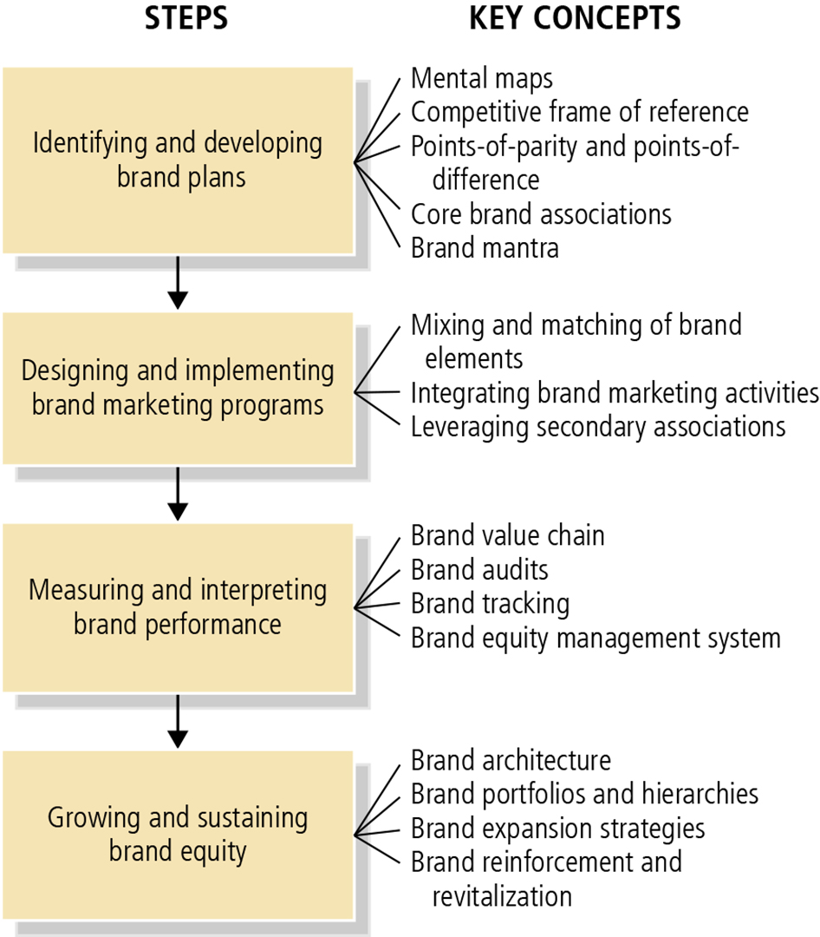
Figure 1-10: Strategic Brand Management Process

Slide 44
Designing and Implementing Brand Marketing Programs
Choosing Brand Elements
Integrating the Brand into Marketing Activities and the Supporting Marketing Program
Leveraging Secondary Associations
Notes:
Choosing brand elements:
The best test of the brand-building contribution of a brand element is what consumers would think about the product or service if they knew only its brand name or its associated logo or other element.
Integrating the brand into marketing activities and the supporting marketing program:
Although the judicious choice of brand elements can make some contribution to building brand equity, the biggest contribution comes from marketing activities related to the brand.
Leveraging secondary associations:
Because the brand becomes identified with another entity, even though this entity may not directly relate to the product or service performance, consumers may infer that the brand shares associations with that entity, thus producing indirect or secondary associations for the brand.

Slide 45
Measuring and Interpreting Brand Performance
To manage brands profitably, managers must implement a brand equity measurement system
Brand equity measurement system involves:
  Brand audits
  Brand tracking studies
  Brand equity management system
Notes:
Brand equity measurement system:
A set of research procedures designed to provide timely, accurate, and actionable information for marketers so that they can make the best possible tactical decisions in the short run and the best strategic decisions in the long run:
Brand audits: Comprehensive examination of a brand to assess its health, uncover its sources of equity, and suggest ways to improve and leverage that equity.
Brand tracking studies: Collect information from consumers on a routine basis over time, typically through quantitative measures of brand performance on a number of key dimensions marketers can identify in the brand audit or other means.
Brand equity management system: Set of organizational processes designed to improve the understanding and use of the brand equity concept within a firm.
Three steps that help implement a brand equity management system are:
Creating brand equity charters,
Assembling brand equity reports, and
Defining brand equity responsibilities.

Slide 46
Growing and Sustaining Brand Equity
Defining Brand Architecture
Managing Brand Equity over Time
Managing Brand Equity over Geographic Boundaries, Cultures, and Market Segments
Notes:
Defining brand architecture:
Provides general guidelines about branding strategy and the brand elements to be applied across all the different products sold by the firm.
Two key concepts in defining brand architecture are:
Brand portfolio: Set of different brands that a particular firm offers for sale to buyers in a particular category.
Brand hierarchy: Displays the number and nature of common and distinctive brand components across the firm’s set of brands.
Managing brand equity over time:
A long-term perspective of brand management recognizes that any changes in the supporting marketing program for a brand may affect the success of future marketing programs.
Produces proactive strategies designed to enhance customer-based brand equity and reactive strategies to revitalize a brand that encounters problems.
Managing brand equity over geographic boundaries, cultures, and market segments:
In expanding a brand overseas, managers need to build equity by relying on specific knowledge about the experience and behaviors of those market segments.

Slide 47

Copyright
This work is protected by United States copyright laws and is provided solely for the use of instructors in teaching their courses and assessing student learning. Dissemination or sale of any part of this work (including on the World Wide Web) will destroy the integrity of the work and is not permitted. The work and materials from it should never be made available to students except by instructors using the accompanying text in their classes. All recipients of this work are expected to abide by these restrictions and to honor the intended pedagogical purposes and the needs of other instructors who rely on these materials.

