Slide 1
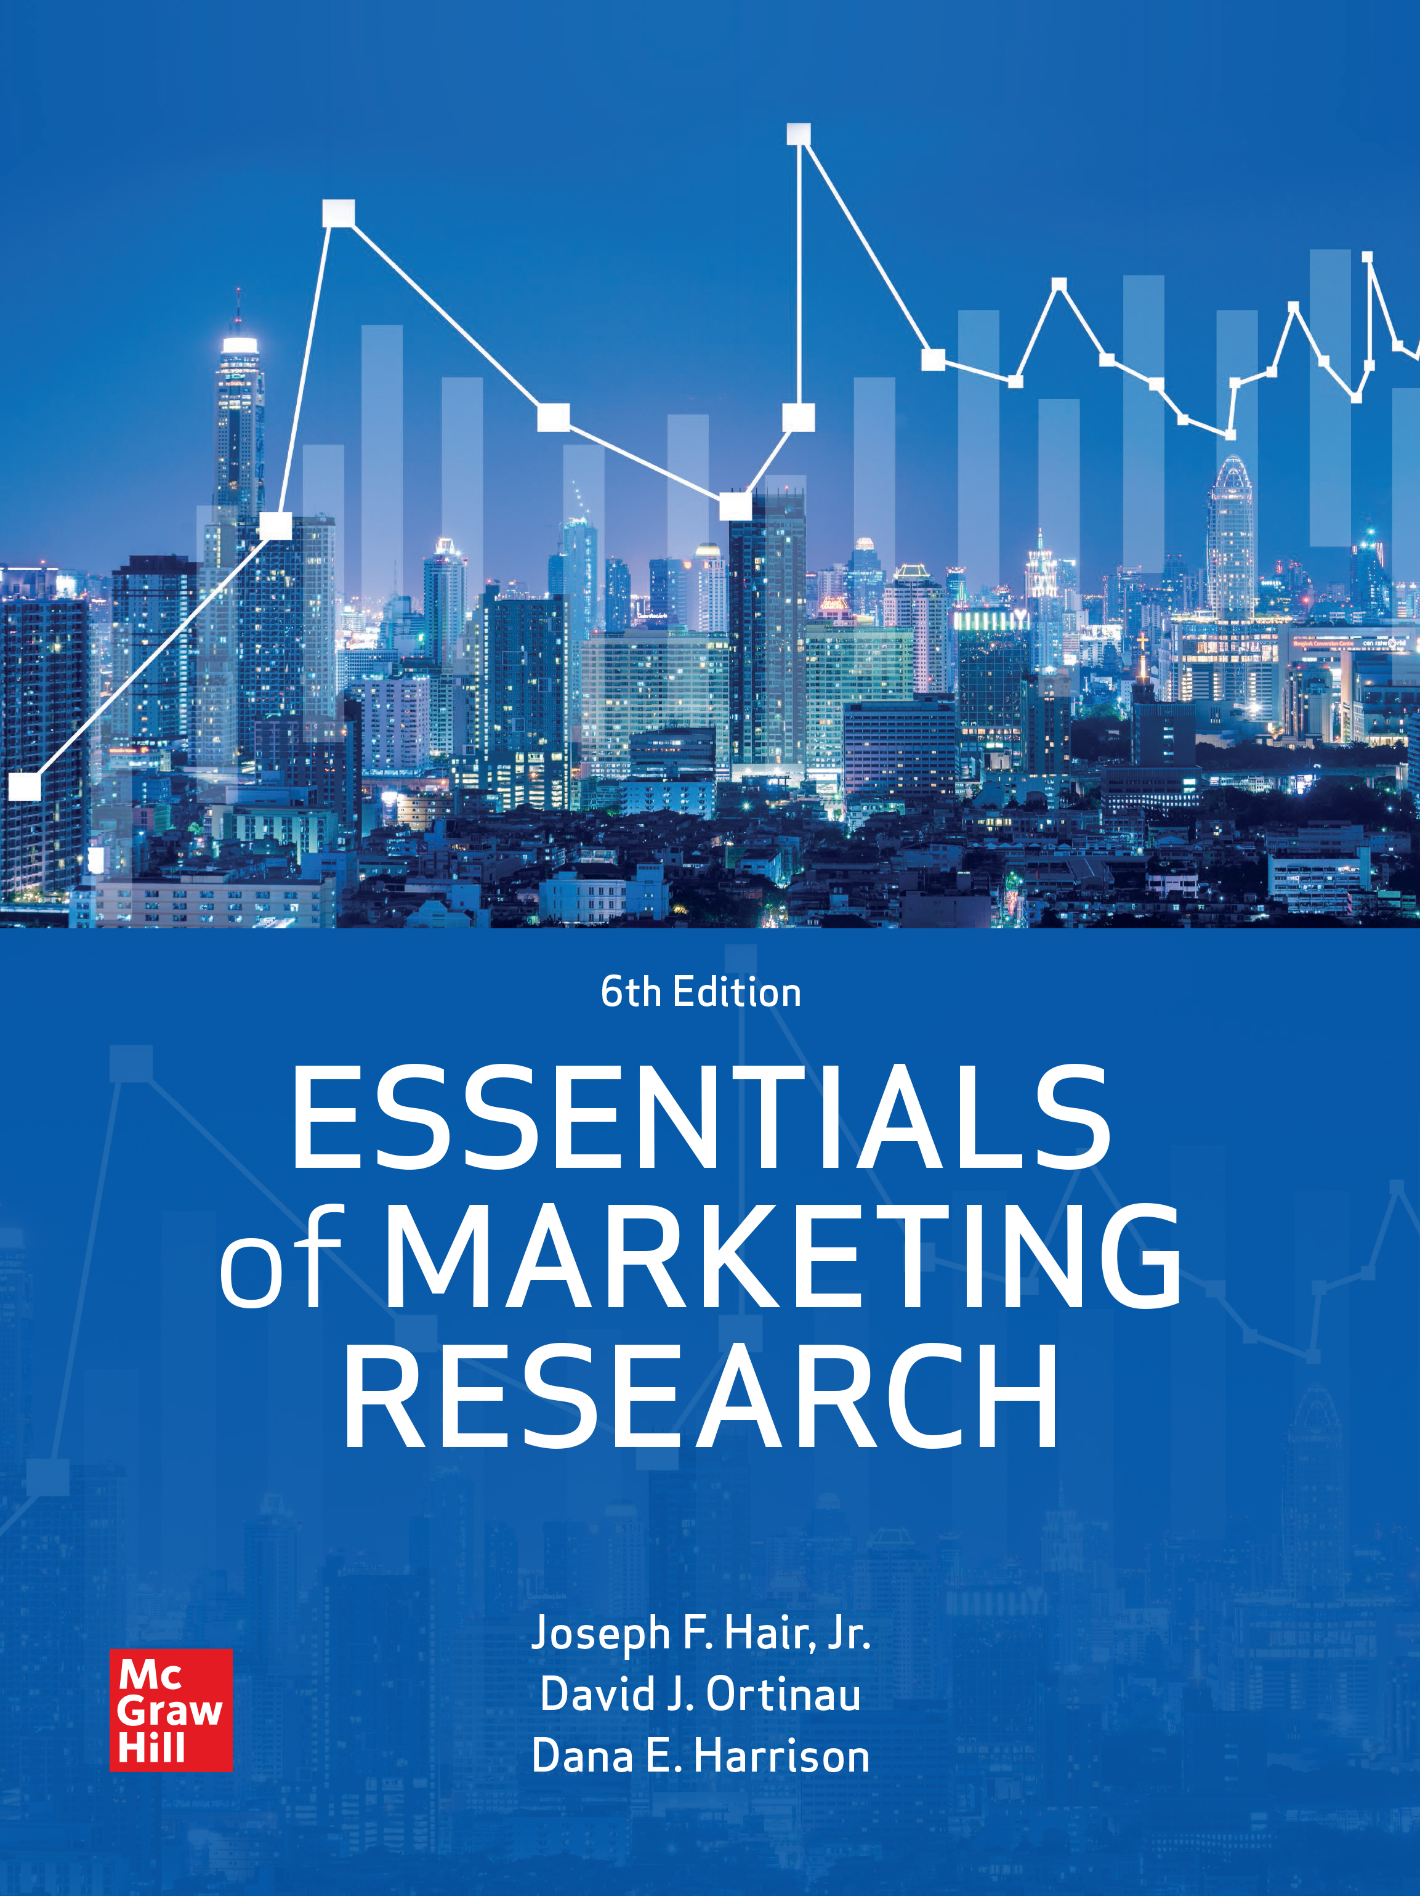
Chapter 01
Marketing Research for Managerial Decision Making
ESSENTIALS of MARKETING RESEARCH
Sixth Edition
Joseph F. Hair, Jr. , David J. Ortinau, Dana E. Harrison
© McGraw Hill LLC. All rights reserved. No reproduction or distribution without the prior written consent of McGraw Hill LLC.

Slide 2
The Growing Complexity of Marketing Research
Databases or data warehouses store big data.
  Many companies use a customer relationship management (CRM) system to manage information.
Digital advances provide new data collection opportunities.
  Hybrid research techniques use multiple methods.
Marketing research is the function that links an organization to its market through the gathering of information.
Marketing research tasks include:
  Designing ways to collect information.
  Managing the collection process.
  Analyzing and interpreting results.
  Sharing results with decision makers.

Slide 3
The Role and Value of Marketing Research
Managerial decisions may involve new contexts where experience may be absent or even misleading.
  Marketing research draws on the social sciences for methods/theory.
  Recently, the size of the toolbox has grown with “big data.”
Marketers must first understand the questions that need to be addressed, then use the appropriate tool and technique.
  Marketing research applies to problems involving the four Ps.
  Theoretical research helps marketers understand questions applicable to a broad variety of marketing contexts.

Slide 4
Marketing Mix Variables – Product
New product development and introduction
  Concept and product testing or test marketing answers two questions.
  How does a product perform for the customer?
  How can a product be improved or exceed customer expectations?
Branding.
  Research detects early changes in meaning and attitudes.
Positioning.
  Understanding how consumers perceive products.
  Perceptual mapping fixes products on two or more dimensions impacting purchase.

Slide 5
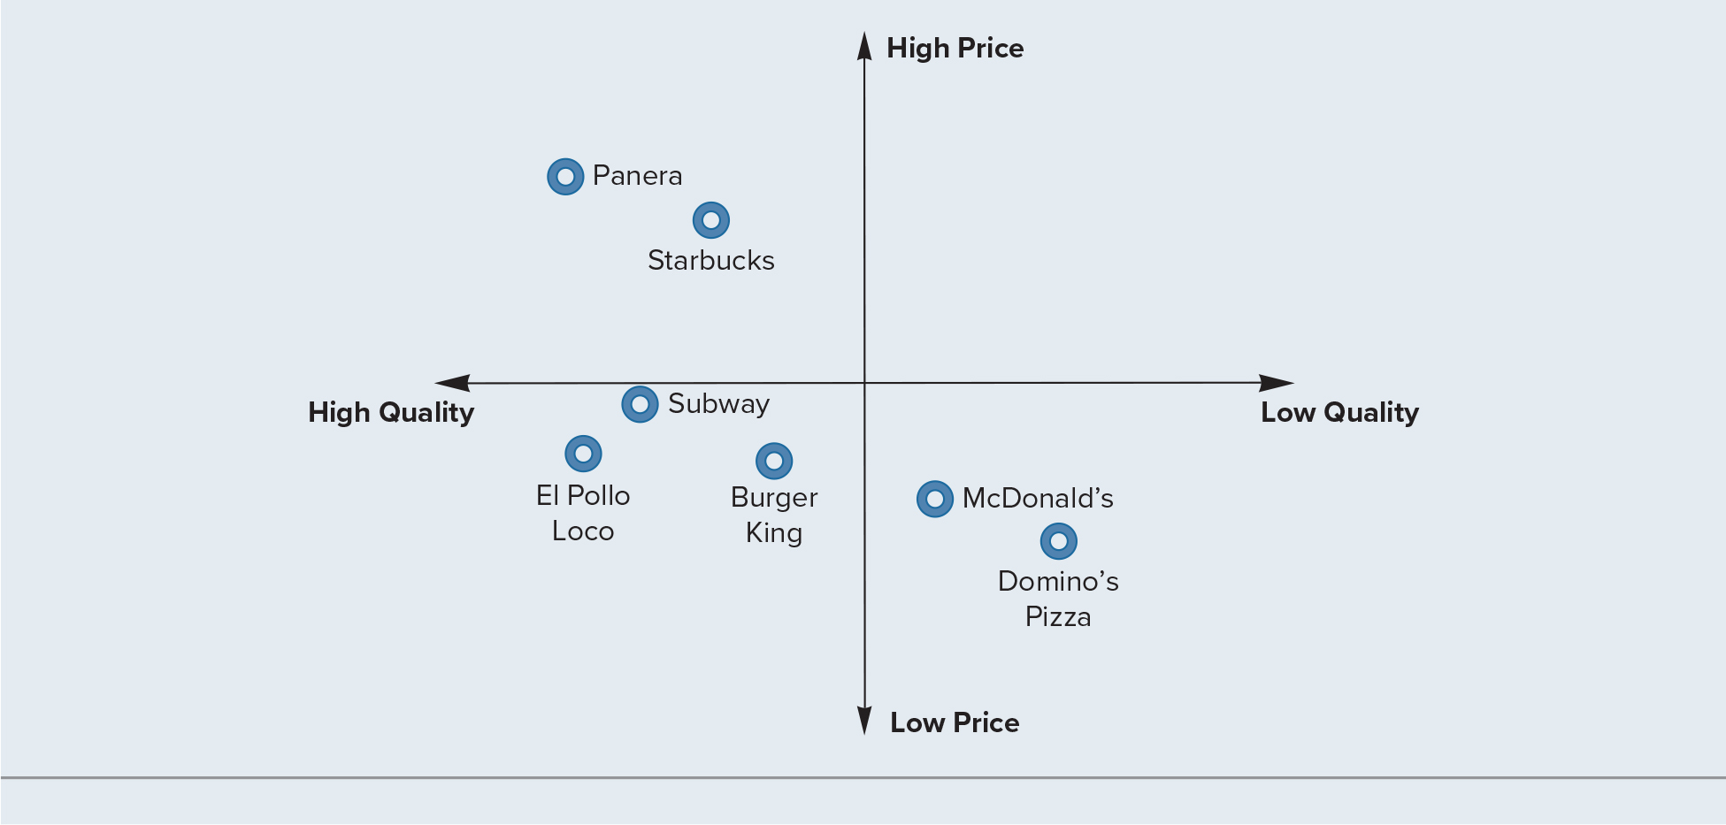
Exhibit 1.1: Perceptual Map of the Fast Food Market
Access the text alternative for these images

Slide 6
Marketing Mix Variables—Place/Distribution
Retail market research includes: trade area analysis, store image studies, in-store traffic patterns, and location analysis.
  Retailing research focuses on database development through optical scanning at the point of purchase.
Online retailers face unique challenges and opportunities.
  In behavioral targeting, online retailers work with content sites to display ads based on data collected about user behavior.
Shopper marketing gives an understanding of a customer’s purchase journey and addresses:
  Product category management.
  Displays, sales, packaging, promotion, and marketing.

Slide 7
Marketing Mix Variables—Promotion
Companies must know how to obtain good returns from their promotional budgets.
  Traditional and digital media present challenges in obtaining reliable metrics to accurately gauge advertising return.
  Market researchers must develop meaningful metrics and then collect the data for those metrics.
Three common research tasks in integrated marketing communications:
  Advertising effectiveness studies.
  Attitudinal research.
  Sales tracking.

Slide 8
Marketing Mix Variables—Price
Pricing decisions involve pricing new products, establishing price levels in test marketing, and modifying prices for existing products.
Marketing research provides answers to these questions.
  How large is the demand potential within the target market at various price levels?
  What are the sales forecasts at various price levels?
  How sensitive is demand to changes in price levels?
  Are there identifiable segments that have different price sensitivities?
  Are there opportunities to offer different price lines for different target markets?

Slide 9
Consumers and Markets—Segmentation Studies
Benefit and lifestyle studies examine consumers’ needs.
  This is a major component of market segmentation research.
  Objective—data on customer characteristics, product benefits, and brand preferences.
  Combined with other demographics, it provides segmentation profiles.
Although useful, more detailed information may be needed.
Ethnography requires extended observation of consumers in context.
It highlights problems and opportunities based on consumer behavior.

Slide 10
Marketing Theory
The purpose of theory is to generalize relationships between concepts in a way applicable to a wide variety of settings.
  Adoption and diffusion theory helps marketers understand how new products are adopted and spread through the market.
  Services marketing research found five characteristics important to consumers—reliability, empathy, responsiveness, assurance, and tangibles.
  Information overload theory explains why consumers are more likely to purchase from a sample of 6 versus 24.
  In sales research, likability, similarity, and trustworthiness are characteristics linked to a salespersons’ success.

Slide 11
The Marketing Research Industry
This industry has experienced record growth, due to:
  Post-sale customer satisfaction studies—a third of research company revenues.
  Retail-driven product scanning systems—also a third of revenues.
  Database development for long-term brand management.
  International research studies.

Slide 12
Types of Marketing Research Firms
Internal or external—a unit within the company, or hiring a firm on a fee basis.
Customized or standardized
  Customized research firms provide tailored services while standardized research firms provide general services.
  Many standardized research firms provide syndicated business services.
Brokers or other facilitators.

Slide 13
Changing Skills for a Changing Industry
A unique skill base is required in a research firm.
  Communication skills, both verbal and written.
  Interpersonal skills—ability to work with others.
  Statistical skills.
Top five skills candidates need for marketing jobs:
  Understand and interpret secondary data.
  Presentation skills.
  Foreign language competency.
  Negotiation skills.
  Information technology proficiency.

Slide 14
Ethical Questions in General Business Practices
Pricing issues.
  “Soft” costs are used to pad the total project cost.
  Selling nonessential services is unethical.
Client confidentiality issues.
  When firms specialize, it is tempting to reuse research results from one client to another.
Selling of branded “black box” methodologies.
  Methodologies are black box when they are proprietary and firms will not fully disclose how the methodology works.
  A methodology is not a black box just because it is branded.

Slide 15
Conducting Research Not Meeting Professional Standards
Due to client pressure, research providers may conduct research that does not meet professional standards.
  One client pressure is to prove a predetermined conclusion.
  The client may not provide a sufficient budget.
Interviewers working for research firms may engage in curbstoning by completing answers themselves.
  They may also have friends fill out surveys.
  They may not use the designated sample but rather anyone conveniently available.
  They may not follow up on callback procedures.

Slide 16
Abuse of Respondents
Research firms may neglect incentives, misrepresent time requirements, or use fake sponsors.
  If deception is necessary, “debrief” afterwards.
Research used just to collect names is unethical.
  Sugging or frugging.
Market researchers should not invade customer privacy
The Marketing Research Association has guidelines.
  They prohibit researchers from deanonymizing data.
  Online information can be “deanonymized.”
  Online actions may be observed but with no identifying information.

Slide 17
Unethical Activities of the Client/Research User
“Clients” may request research proposals from several companies with no intention of hiring any of them.
  Instead using the information to perform the research themselves.
Another behavior is to promise a research provider a long-term relationship in order to obtain a low price.
  Then providing no further business to the research firm.
Clients may also be tempted to overstate results of a marketing research project.

Slide 18
Unethical Activities by the Respondent
The primary unethical practice is to provide dishonest answers or fake behavior.
  Respondents frequently provide untrue answers to questions related to income or to their indulgence in sensitive behaviors.
If there is the prospect of earning money—respondents lie to match the characteristics the screeners are seeking.
  This undermines the validity of the research.

Slide 19
Marketing Research Codes of Ethics
The Statement of Ethics for the American Marketing Association says:
  Researchers will conform to all laws and behave ethically.
  Use special care when conducting research among children.
  Respondents’ cooperation is voluntary.
  Rights of respondents as private individuals is respected.
  Never allow personal data to be used for any other purpose.
  Ensure work is accurate, transparent, objective, and appropriate.
  Researchers will conform to principles of fair competition.

Slide 20
Emerging Trends: Marketing Research Industry
Five major trends are becoming evident.
  Increased emphasis on secondary data collection methods.
  Movement toward technology-related data management.
  Expanded use of digital technology for information acquisition and retrieval.
  A broader international client base.
  Movement beyond data analysis toward a data interpretation/ information management environment.

Slide 21
Emerging Trends: The Development of Marketing Analytics
Marketing analytics uses data, statistics, mathematics, and technology to solve marketing business problems.
Marketing analytics and big data rely on:
  Vast amounts of digital secondary data.
  Enhanced computer processing power.
  Knowledge of mathematical modeling.
  Computer programming skills.
  Access to specialized software.
Analytics techniques vary in complexity from simple to advanced.

Slide 22
End of Main Content
© McGraw Hill LLC. All rights reserved. No reproduction or distribution without the prior written consent of McGraw Hill LLC.

Slide 23
Accessibility Content: Text Alternatives for Images

Slide 24
Exhibit 1.1: Perceptual Map of the Fast Food Market - Text Alternative
Return to parent-slide containing images.
The vertical axis plots price ranging from low to high and the horizontal axis plots quality ranging from high to low. The graph plots the price and quality of seven fast-food restaurants as follows. High quality and high price- Panera, and Starbucks. The price and quality of Starbucks are relatively lower than that of Panera. High quality and low price: El Pollo Loco, Subway, and Burger king; the price and quality of Burger King are relatively lower than the other two. El Pollo Loco has high quality and is almost the same price as that of Burger King. Subway has the lowest price and the quality is between that of El Pollo Loco and Burger King. Low price and low quality- McDonald’s and Domino’s Pizza. The price and quality of McDonald’s are relatively lower than that of Domino’s Pizza.
Return to parent-slide containing images.

