Slide 1
Digital Marketing
Strategy, Implementation and Practice
Eighth Edition
Part 1
Digital marketing fundamentals
Chapter 1
Introducing digital marketing

Slide 2
Chapter 1 – Introducing Digital Marketing
Learning objectives and topics:
Explain how the business opportunities and challenges of digital marketing can be managed using a strategic approach
  Introduction – how has digital marketing transformed marketing?
  Digital marketing goals and strategy
Review the options to achieve communications goals using different types of digital media and platforms
  Digital marketing audiences and buyer behaviour
  Digital devices and digital platforms
  Digital media

Slide 3
Chapter 1 – Introducing Digital Marketing (Continued)
Review how different types of marketing data and technology can be used to improve audience experiences and support business goals
  Digital data
  Digital marketing technology
Case study 1. Boo hoo: learning from Boo.com – the largest European dot.com failure and the success of Boohoo.com

Slide 4
What is digital marketing?
Digital marketing can be simply defined as:
Achieving marketing objectives through applying digital media, data and technology.
This succinct definition helps remind us that it is the results delivered by technology that should determine investment in digital marketing, not the adoption of the technology! We also need to remember that despite the popularity of digital devices for product selection, entertainment and work, we still spend a lot of time in the real world, so integration with traditional media remains important in many sectors.

Slide 5
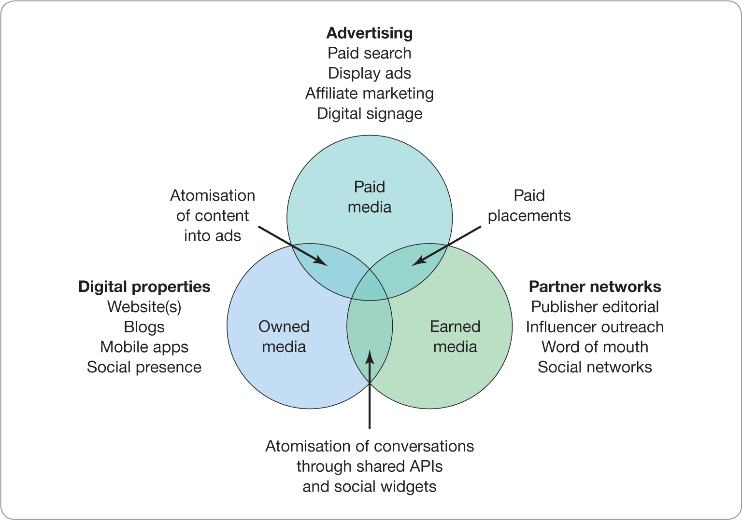
Paid, owned and earned media
Notes:
Figure 1.1
The intersection of the three key online media types

Slide 6
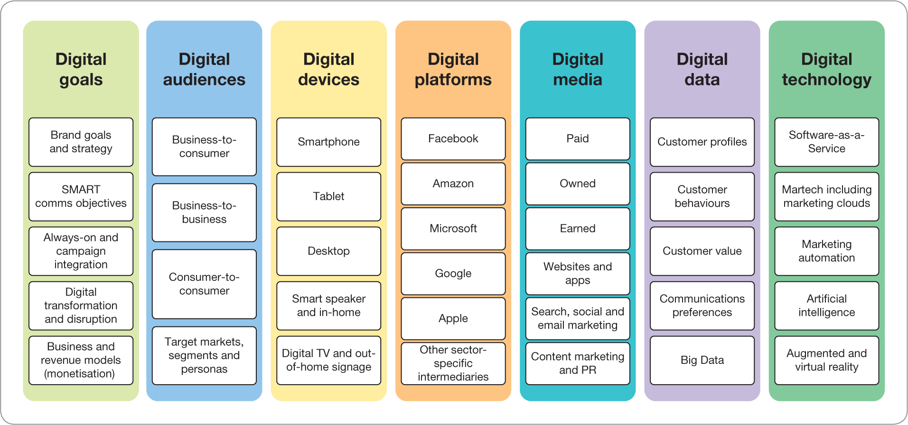
Digital marketing plans need to consider the 7Ds used a focus in the book
Notes:
Figure 1.2
The 7Ds or pillars supporting effective digital marketing

Slide 7
The latest insights on digital marketing adoption?
These presentations integrate the figures and tables from each chapter of the book explaining core concepts for students and lecturers.
They don’t contain the latest statistics on consumer and business adoption of the 7Ds of digital marketing since these change rapidly.
Sources for the latest insights from each chapter and a downloadable presentation of the latest insights are available from www.davechaffey.com/book-support.

Slide 8
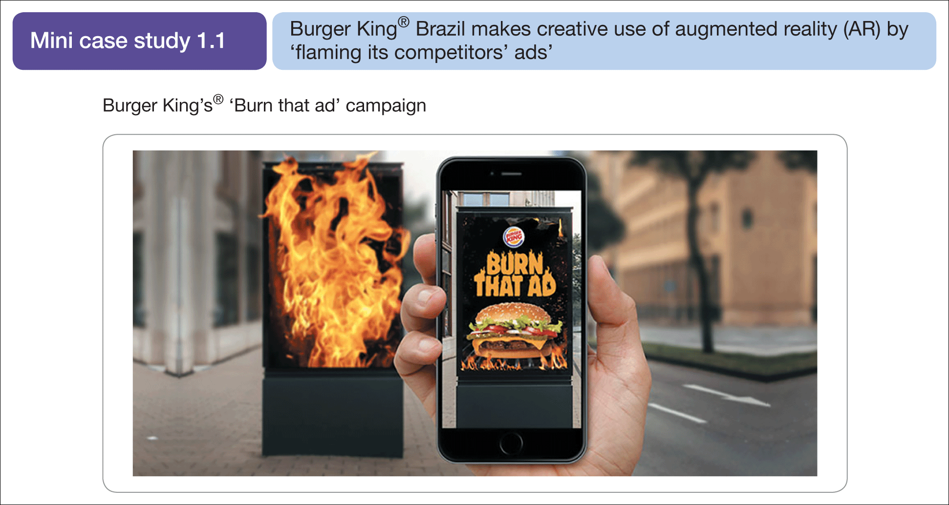
Consider how the 7Ds apply to a marketing campaign like this…
Source: The BURGER KING® and Whopper® trademarks and images are used with permission from Burger King Corporation. All rights reserved

Slide 9
Digital marketing goals and strategy

Slide 10
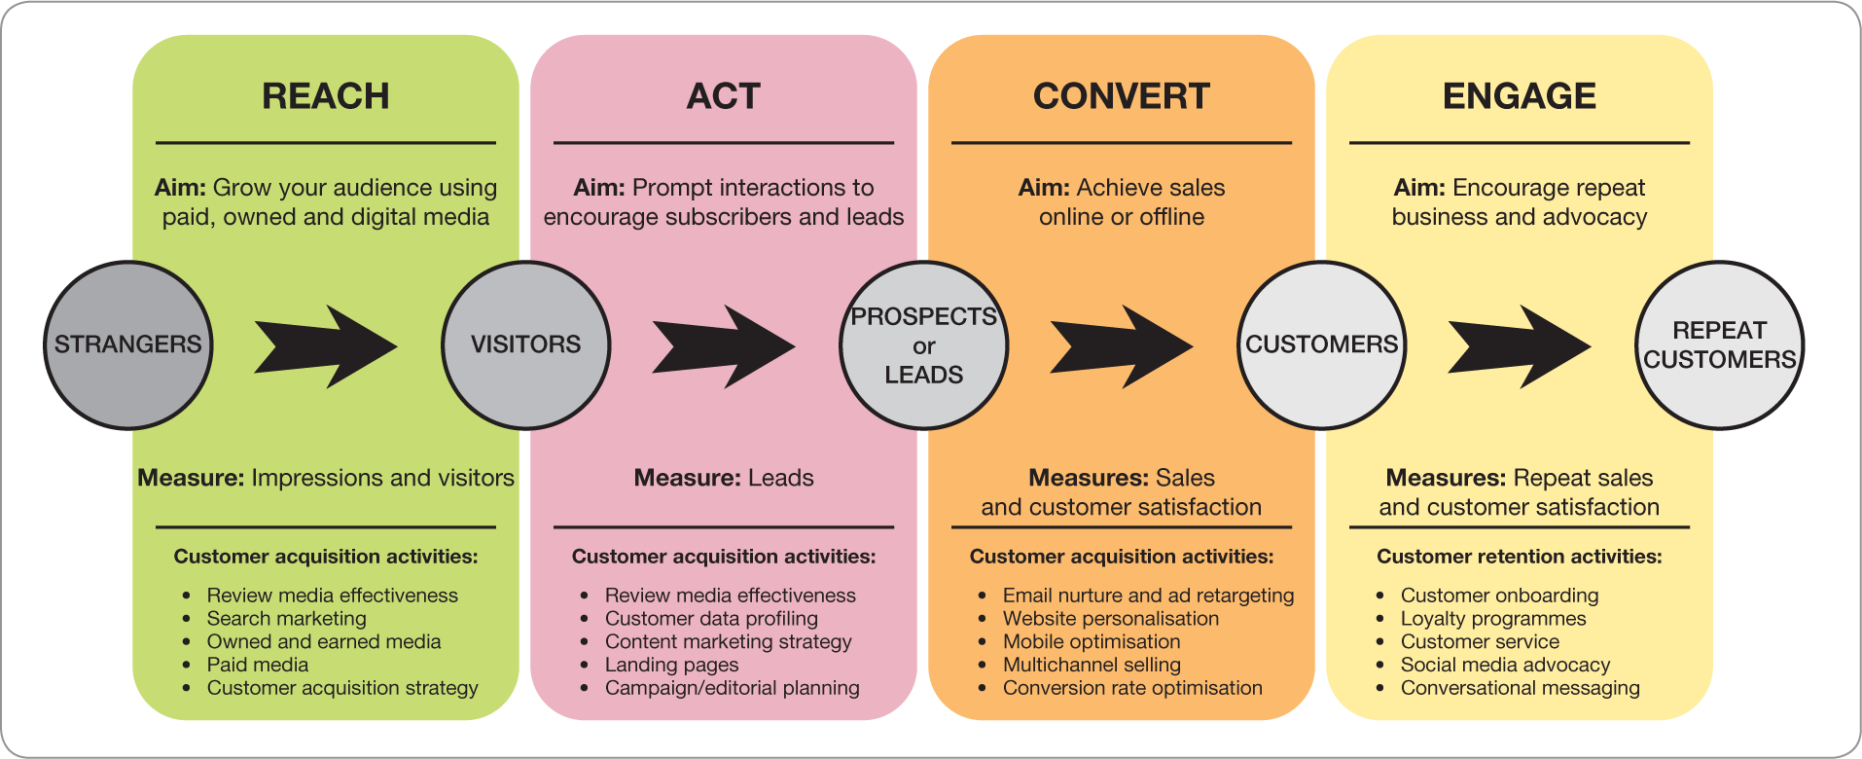
Digital marketing is complex, so frameworks are useful to plan, manage and optimise
Notes:
Figure 1.3
The RACE omnichannel marketing planning framework summarising aims, activities and measures

Slide 11
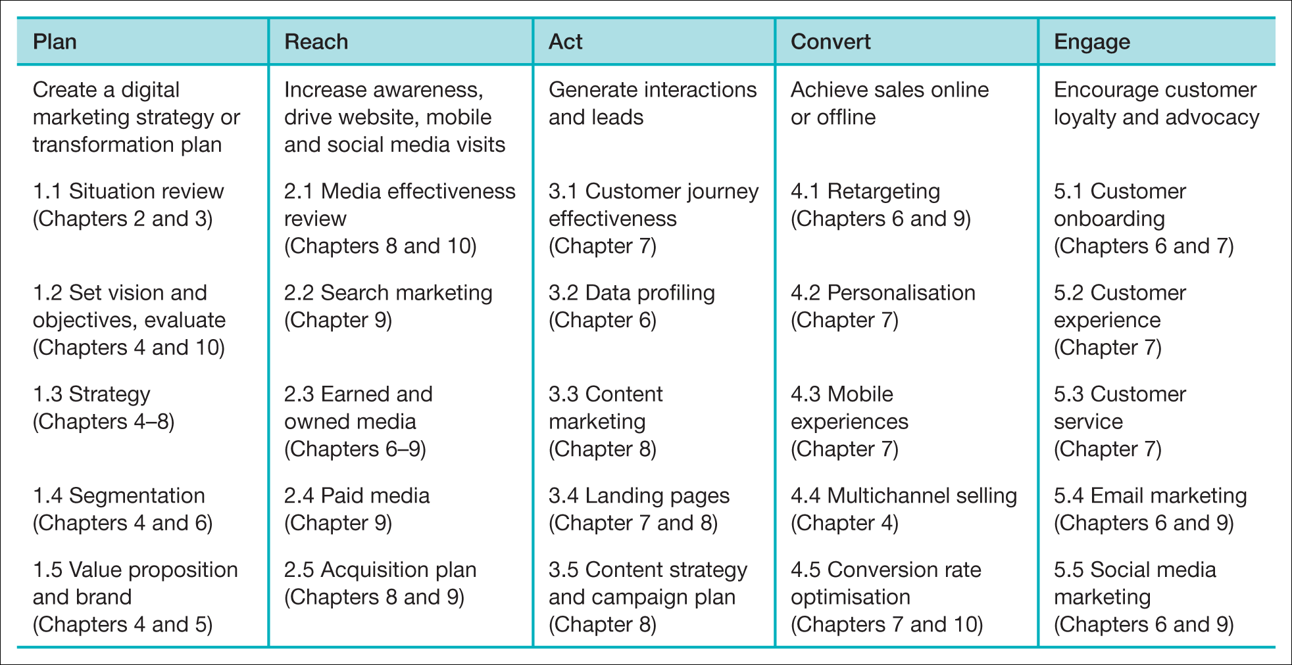
Source: Chaffey (2021)
Notes:
Table P.1
The RACE planning framework for managing key activities for integrated digital marketing across the customer lifecycle

Slide 12
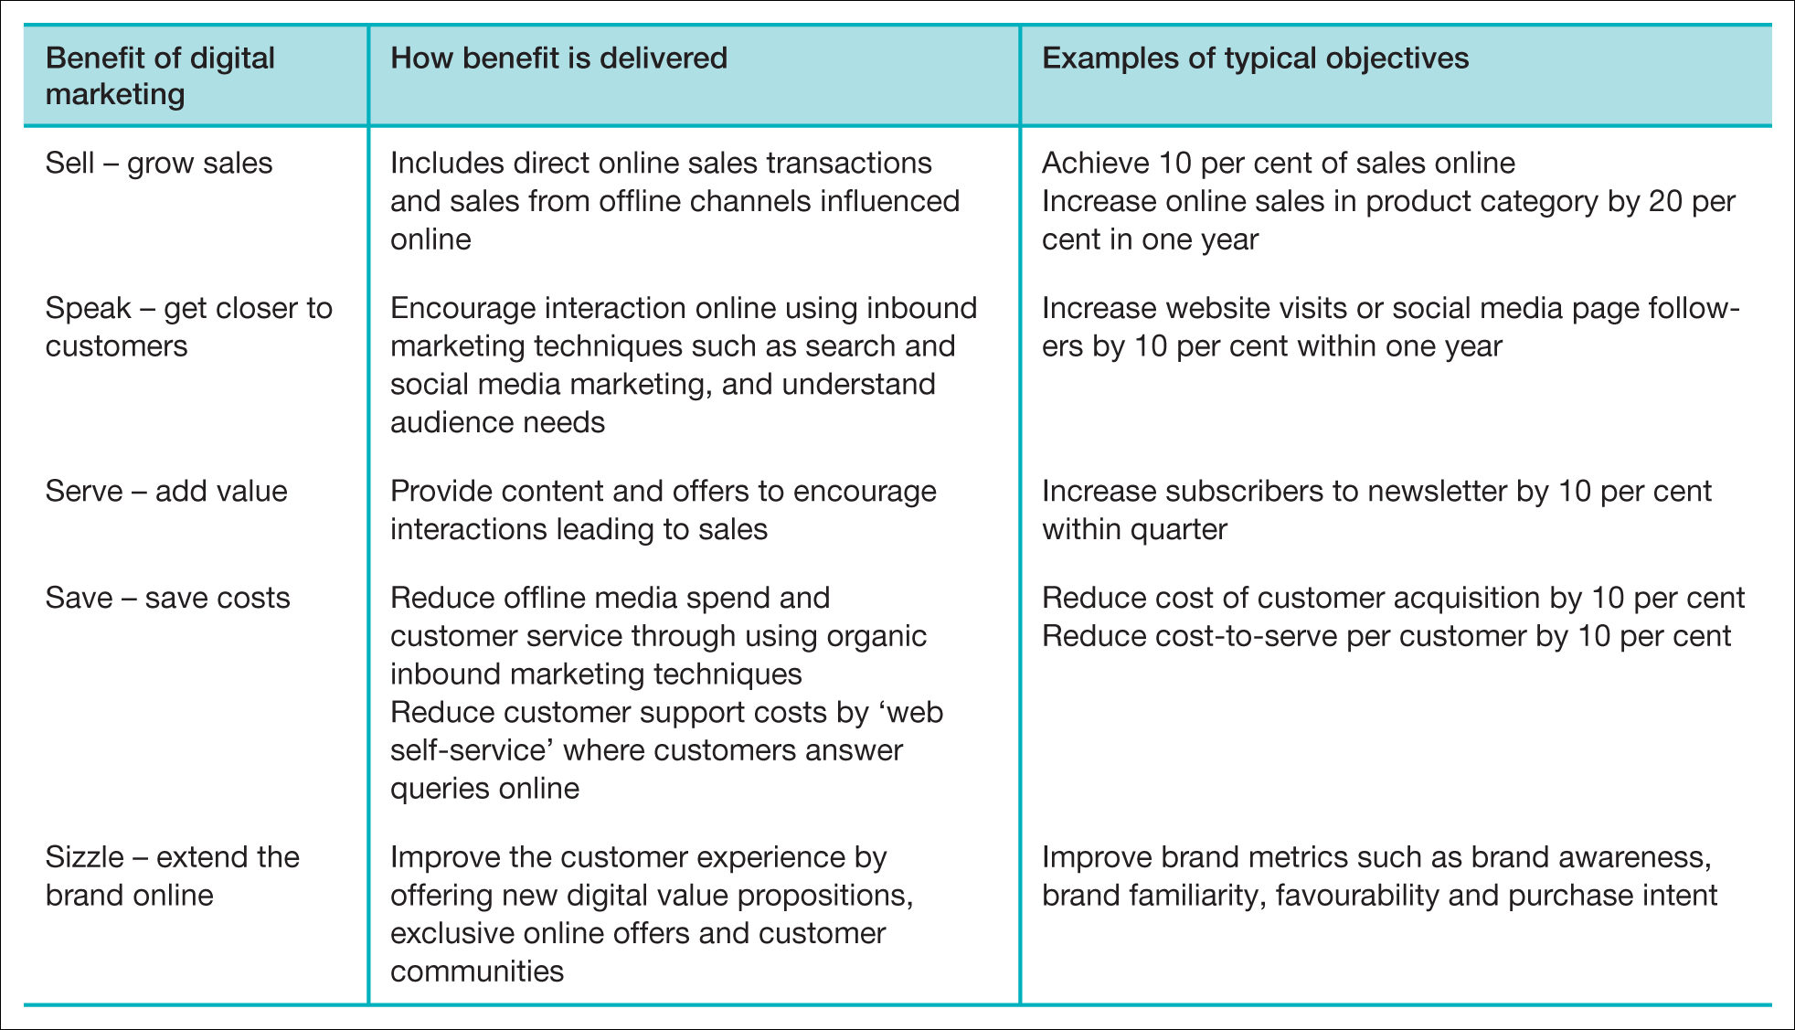
The 5S goals
Source: Chaffey and Smith (2017)
Notes:
Table 1.1
The 5S goals of digital marketing

Slide 13
Emphasis of digital marketing in different types of business. Your examples?
Transactional E-commerce.
Services-oriented relationship-building for lead-building and support
Brand-building
Publisher or intermediary site
Social network or community

Slide 14
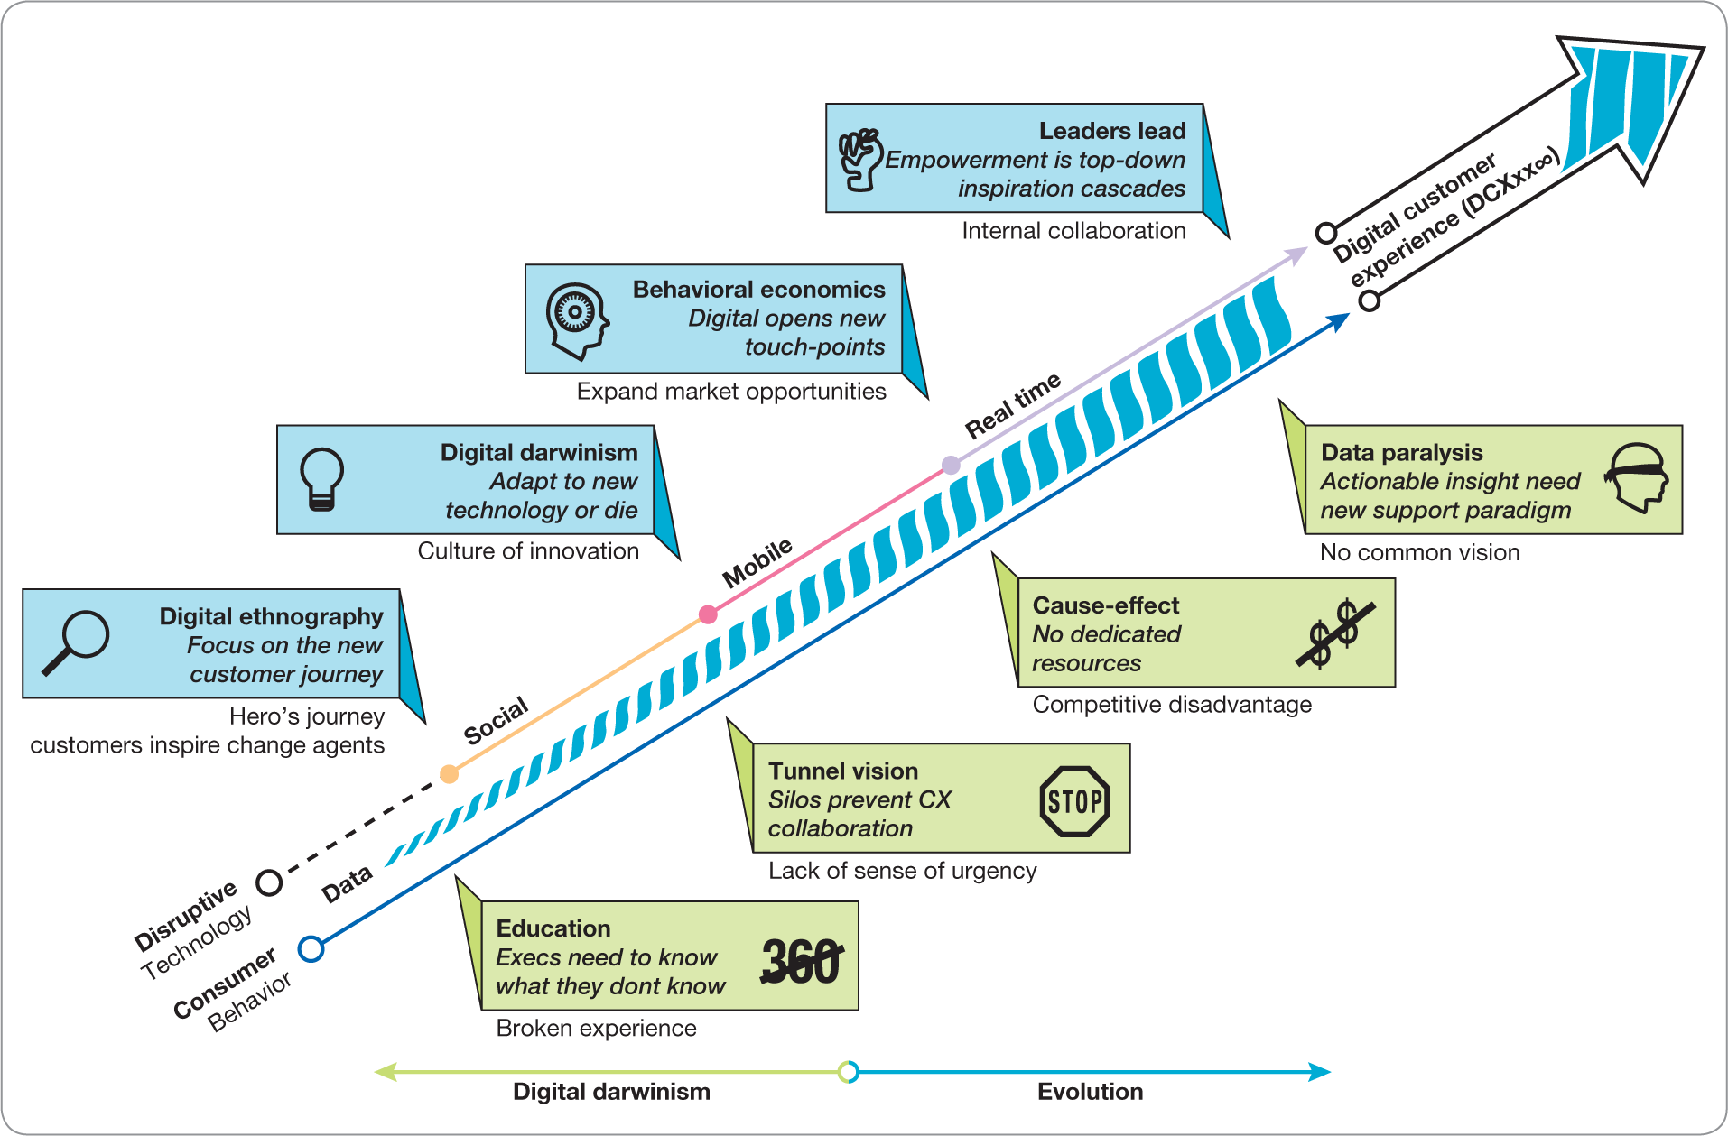
Large, complex organisations may require transformation
Source: Solis (2014)
Notes:
Figure 1.4
The drivers and barriers to digital transformation

